Slide 1
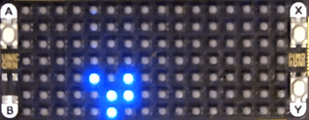
Intro To MAUI For Makers
Dennis Dunn <ansofive@gmail.com>
Notes:
Hello everybody! It’s really good to be back at Stir Trek. Every time I come back I feel like I’m reconnecting with my tribe.
Have you ever built a gadget or a gizmo or a thingamabob and then had a difficult time reconfiguring it for different scenarios? Maybe you needed to change WIFI credentials or drive a robot around the yard. Maybe you found it difficult to change the mash setpoint on your experimental microbrewery.
I was in that exact predicament with a gadget I had made. I despaired of every having a simple way to change the initial conditions. That is until I found out about Microsoft's .NET MAUI framework. The Multi-Platform Application UI framework helps you build apps for multiple platforms from a single codebase. That means one solution targeting Android, IOS, Windows, and Tizen.
I’ll be working with the Microsoft toolchain which means Visual Studio 2022 Community Edition and VS Code. If you want to see MAUI development with the Apple ecosystem check out Sam Basu’s ‘Open Source XAML Takes You Places!’ at 1:00 PM in Sith. If you’re more familiar with web development you might want to corner Heath Murphey or Sam Basu and talk about PWAs and Blazor Webassembly. Heath gave a talk this mourning about the death of mobile apps. We’ll show him!
By the end of the session I hope that you have ideas for new ways to control your own gadgets and the confidence to try out mobile development with .NET MAUI.

Slide 2
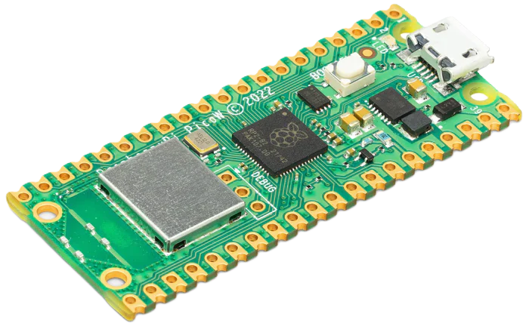
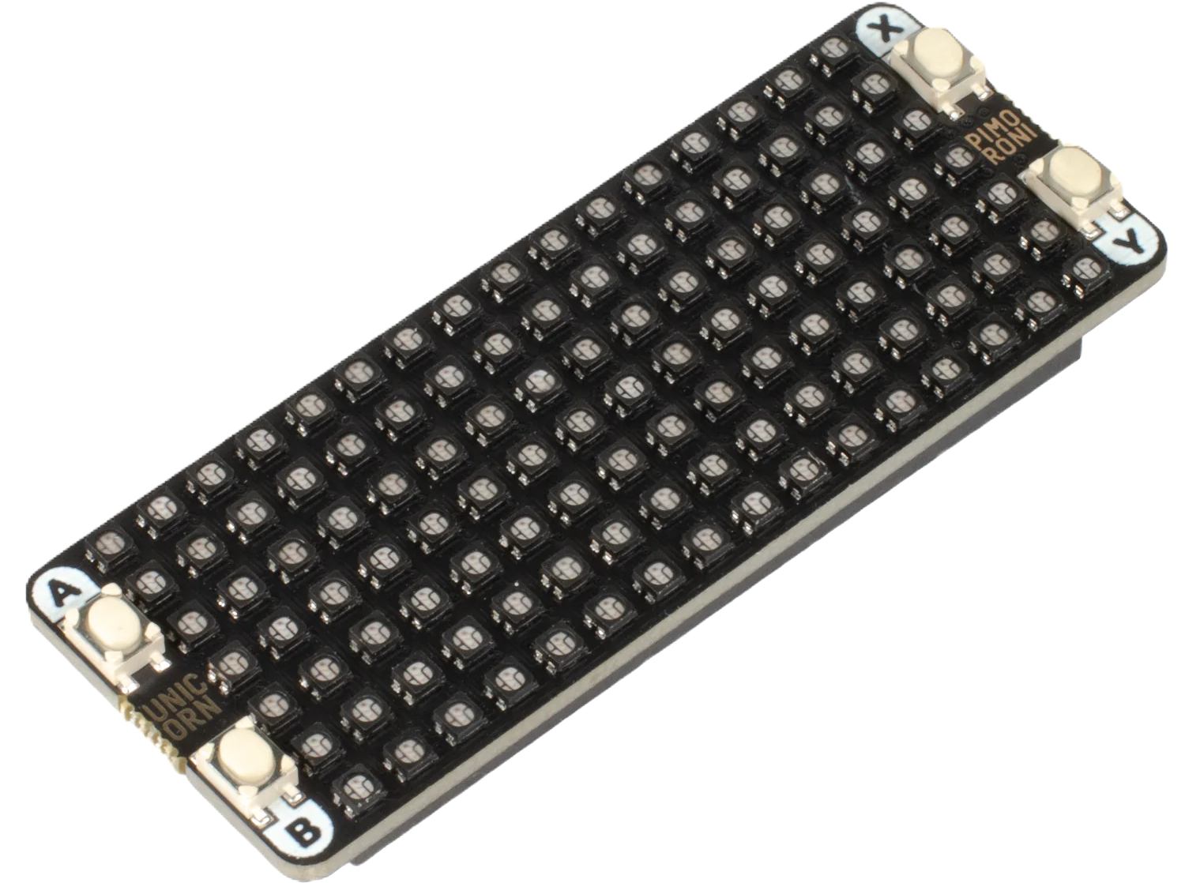

gadget /găj′ĭt/
noun
A small specialized mechanical or electronic device; a contrivance.
Any device or machine, especially one whose name cannot be recalled. Often either clever or complicated.
+
+
=
Notes:
My gadget is made from a Raspberry Pi Pico W, a Pimoroni Pico Unicorn Pack, and the MicroPython runtime.
The Pico iW s a dual-core microcontroller with 2 MB of flash memory, 264 KB of SRAM, WIFI and Bluetooth.
The Unicorn display is a 7x16 matrix of RGB goodness.
The firmware is the MicroPython runtime provided by Pimoroni which contains support for their product line.
Altogether they make up the Conway’s Game Of Life Gadget.

Slide 3
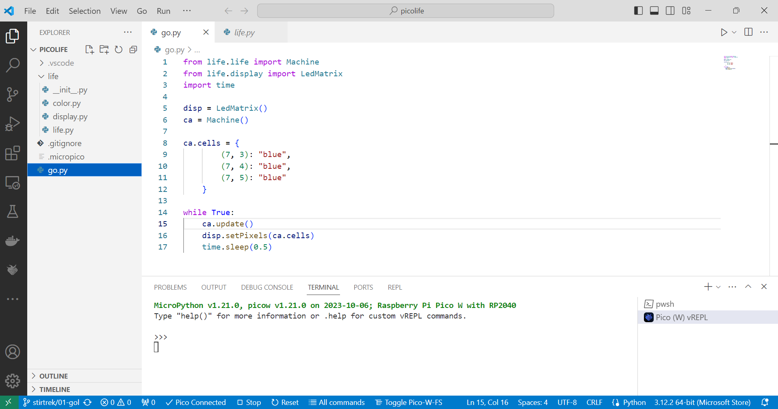
Configuring the Seed
ca.cells = {
(7, 3): "blue",
(7, 4): "blue",
(7, 5): "blue"
}
Notes:
In the first version of the Game Of Life gadget, the state machines initial state, the “seed”, is hardcoded as a Python dictionary literal. Changing the seed, involves:
Start the computer.
Launch an editor.
Change the source code.
Upload the source to the microcontroller.
Reboot the gadget.
This is, shall we say, “sub-optimal.”

Slide 4
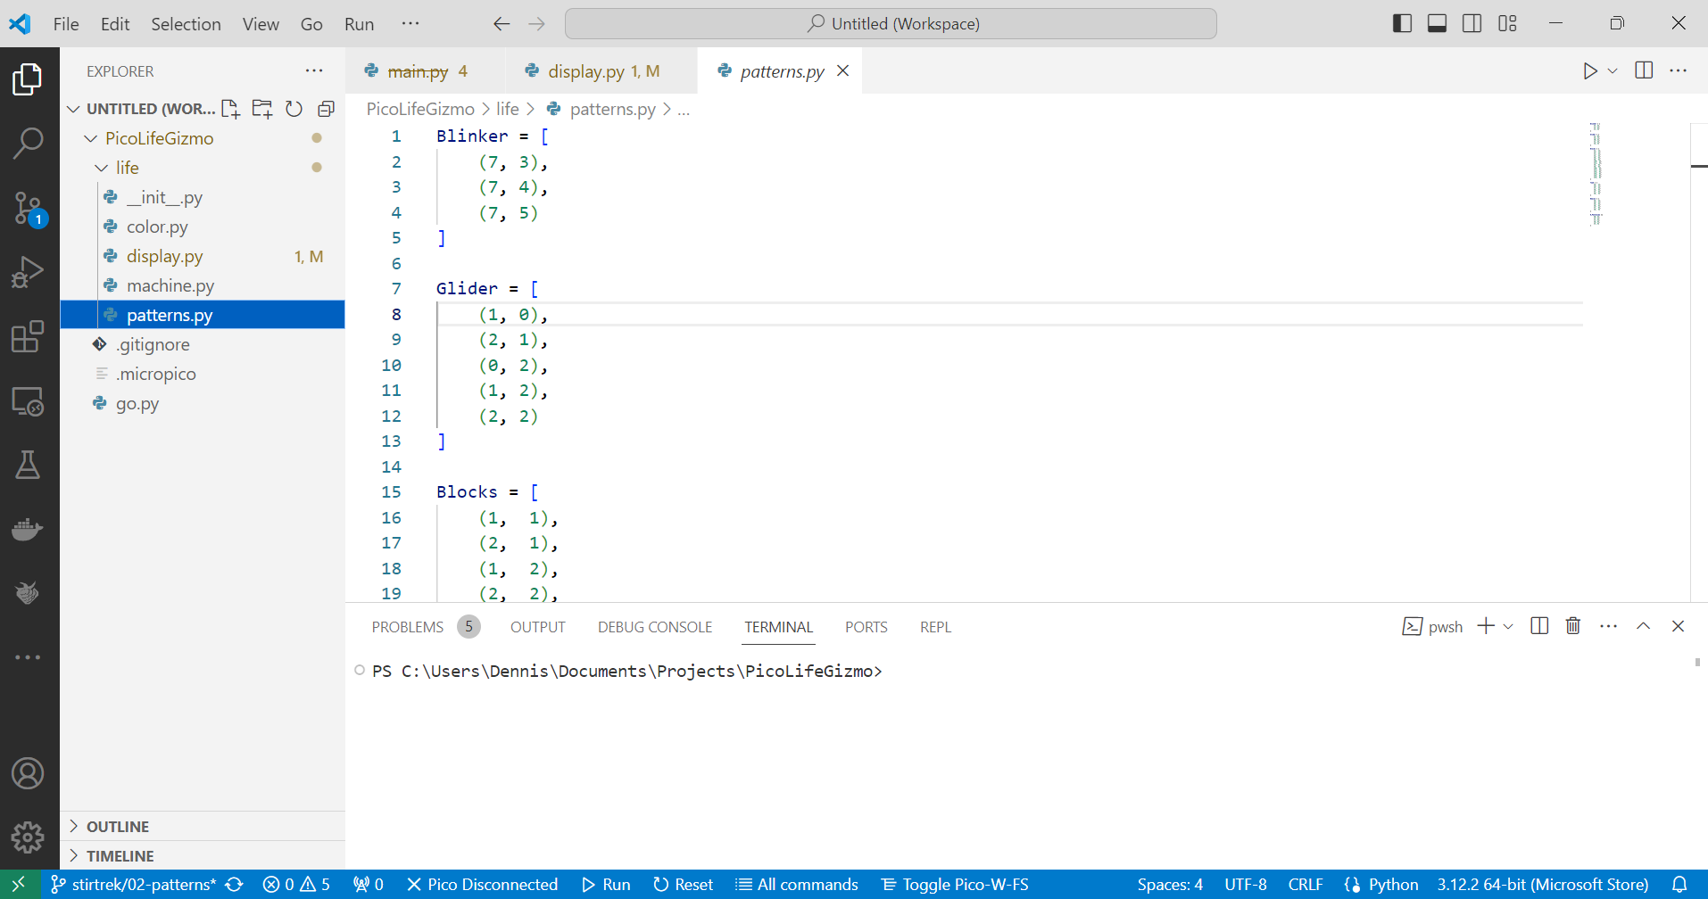
Configuring the Seed as a List
Glider = [
(1, 0),
(2, 1),
(0, 2),
(1, 2),
(2, 2)
]
Notes:
Let’s change how we configure a seed. We’ll make it a named list of tuples instead of a dictionary.
The state machine will have a load() method to transform the list into the dictionary that the FSM needs.

Slide 5
Configuring the Seed as a List
disp = LedMatrix()
ca = Machine()
ca.load(patterns.Glider)
while True:
ca.update()
disp.setPixels(ca.cells)
time.sleep(0.1)
Notes:
This isn’t much better than the previous method of configuring the gadget but it does give us a couple of advantages:
We can store many seeds in a Python module and select among them by name.
The load() method allows us to take any properly formatted list as a seed.
Do those lists need to be hard coded into a module? Of course not!

Slide 6
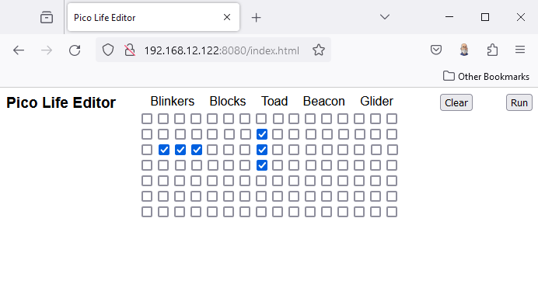
Web-based Configuration
Notes:
Since the Pico W has a WIFI radio, how about we use that?
We’ll install some 3rd party code to make our lives easier.
Mm_wlan for attaching to a WIFI network.
Microdot for a web server.
We’ll POST the results of a form to a web server running on Pico.

Slide 7
Web-based Configuration
@app.post('/cells')
async def set_cells(request):
cells = {}
for cell in request.json:
cells[(cell['x'], cell['y'])] = "green"
self._display.clear()
self._ca.cells = cells
Notes:
Even with my awesome web skills and keen sense of design this solution to the configuration problem isn’t any easier than the previous solution.
We need to provision the WIFI by hardcoding the SSID and the password.
We need to know the URL of the configuration page.
The UI is, how should i put this? Ugly.
Well, how about the other radio on the Pico W - Bluetooth?

Slide 8
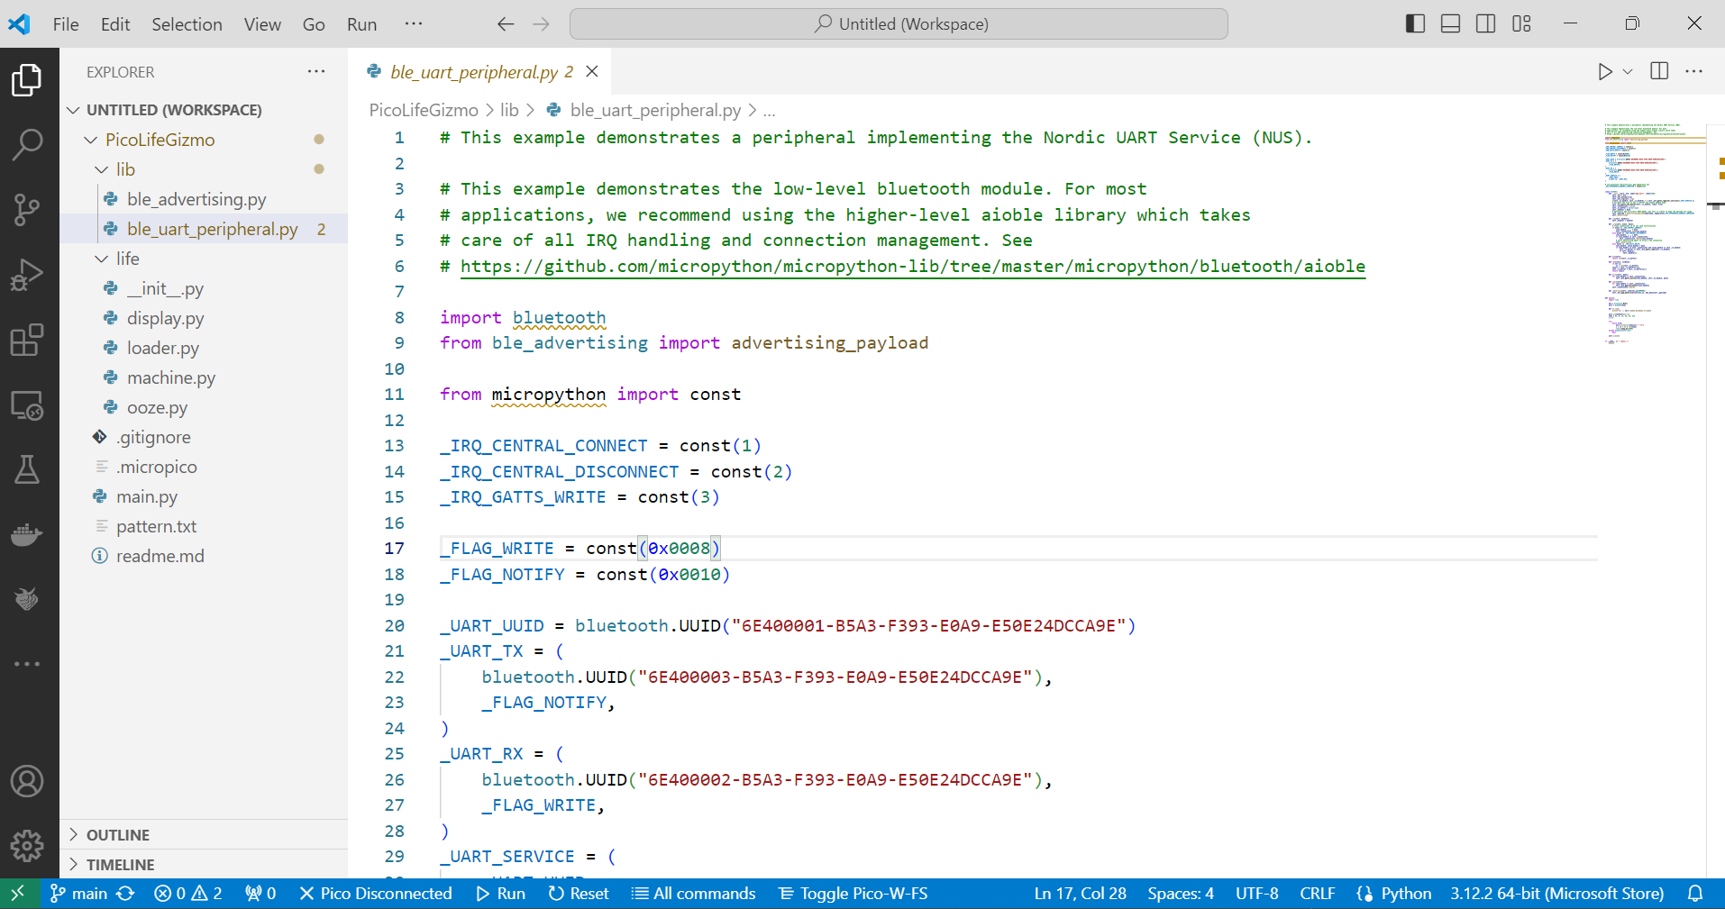
Github is Your Friend
Notes:
First, we need to get the Bluetooth radio on the Pico W to wake up. We have two options here, do it ourselves or find a library and use that. Since we want to succeed, let’s go with Option 2.
The MicroPython repository on Github has plenty of example code that will give you a start with the potentially mind-boggling amount of Bluetooth information.
We’ll use the Nordic UART service for this project. It provides a two-way channel for text data.
I copied two files from the examples repo into my project because I may not now all of the in-and-outs of MicroPython and Bluetooth but I do know how to read code.
When looking at example code to determine what to incorporate into a project I have two criteria:
Simplicity
Pragmatism
It’s hard to argue with “It Works.”

Slide 9
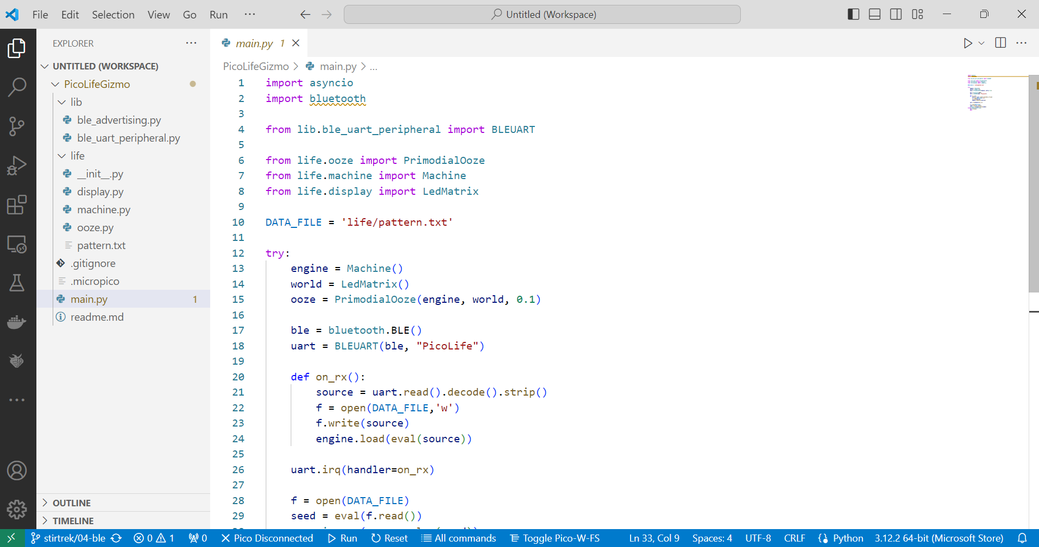
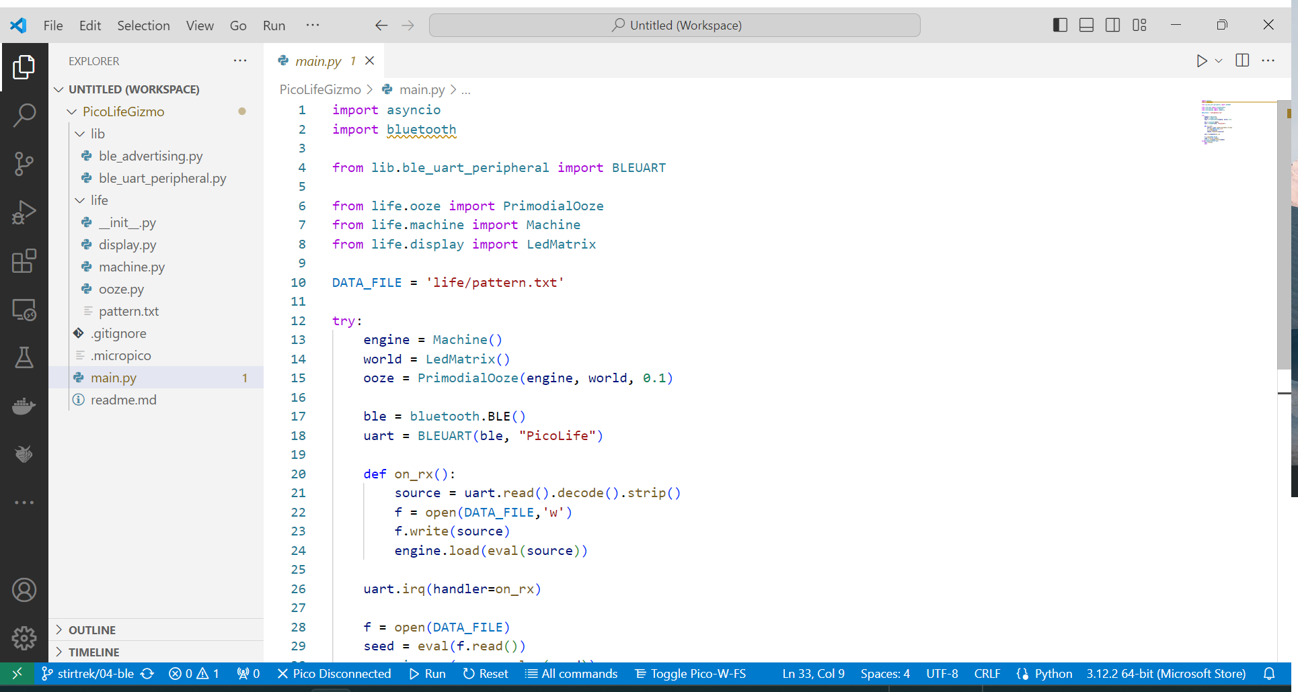
Using the Bluetooth Module
def on_rx():
source = uart.read().decode().strip()
f = open(DATA_FILE,'w')
f.write(source)
engine.load(eval(source))
Notes:
Actually using the module is simple.
First, we’ll define a receive callback. The receive callback accomplishes two tasks;
It saves the object to the gadget so that it is loaded upon boot.
It loads the received list of tuples into the engine.

Slide 10
Using the Bluetooth Module
ble = bluetooth.BLE()
uart = BLEUART(ble, "PicoLife")
Notes:
Next, instantiate a Bluetooth object. This will also start advertising so that the gadget will be visible to Bluetooth scanning.

Slide 11
Using the Bluetooth Module
uart.irq(handler=on_rx)
Notes:
Finally, set the services callback.
If you need even more functionality out of your UART connection take a look at the ble_uart_repl.py example.

Slide 12
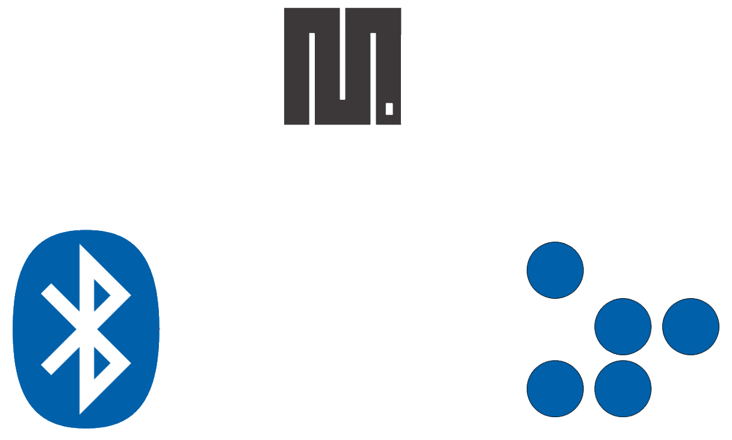
Working Together
MicroPython Scheduler
Bluetooth Process
Gadget Process
Notes:
We want the gadget to continue blinking as well as respond to Bluetooth events. There are a couple of ways to do this;
Preemptive multiprocessing
Cooperative multiprocessing
Both have a set of “processes” or “tasks” that are selected to run by a “scheduler.” The difference is how the scheduler regains control from a process.

Slide 13
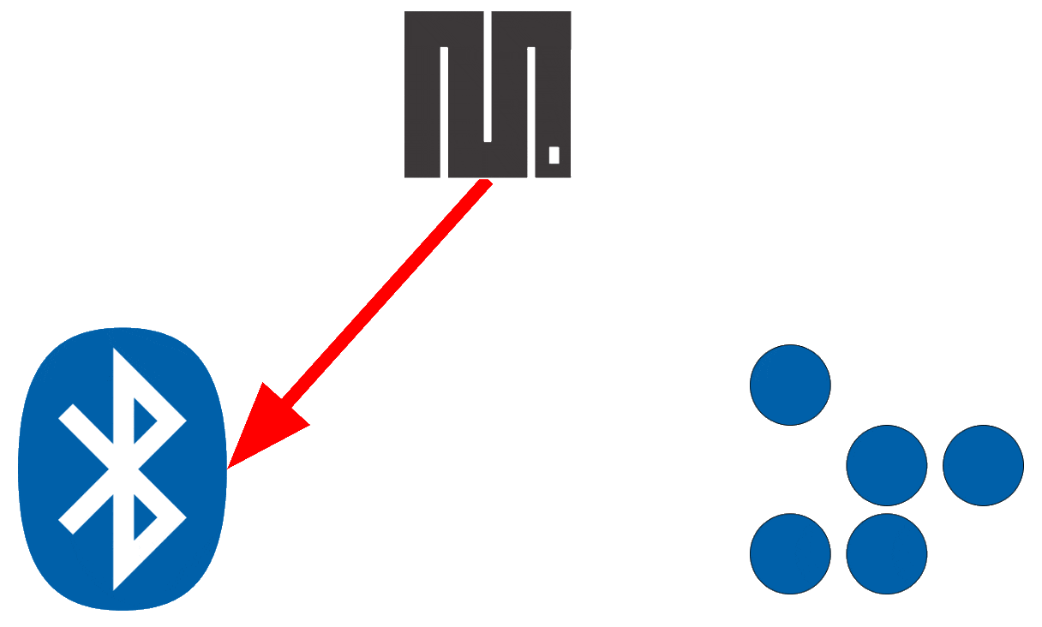
Preemptive Scheduling
Notes:
In a preemptive scheduler, a process is interrupted by the scheduler and control passed to the next process. Since the scheduler can interrupt the process at any point in its execution, the scheduler needs to manage the processes state.

Slide 14
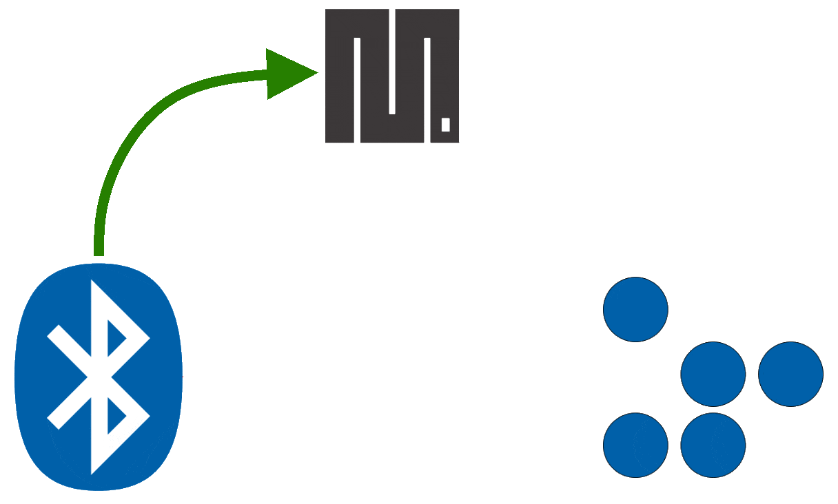
Cooperative Scheduling
Notes:
With a cooperative scheduler, it is up to the process to ensure that it relinquishes control only when it is in a valid state. The scheduler doesn’t need to manage as much state and can therefore be simpler. Simple is good when you have a microcontroller with limited RAM.
MicroPython provides a cooperative multitasking environment in the form of the asyncio library.

Slide 15
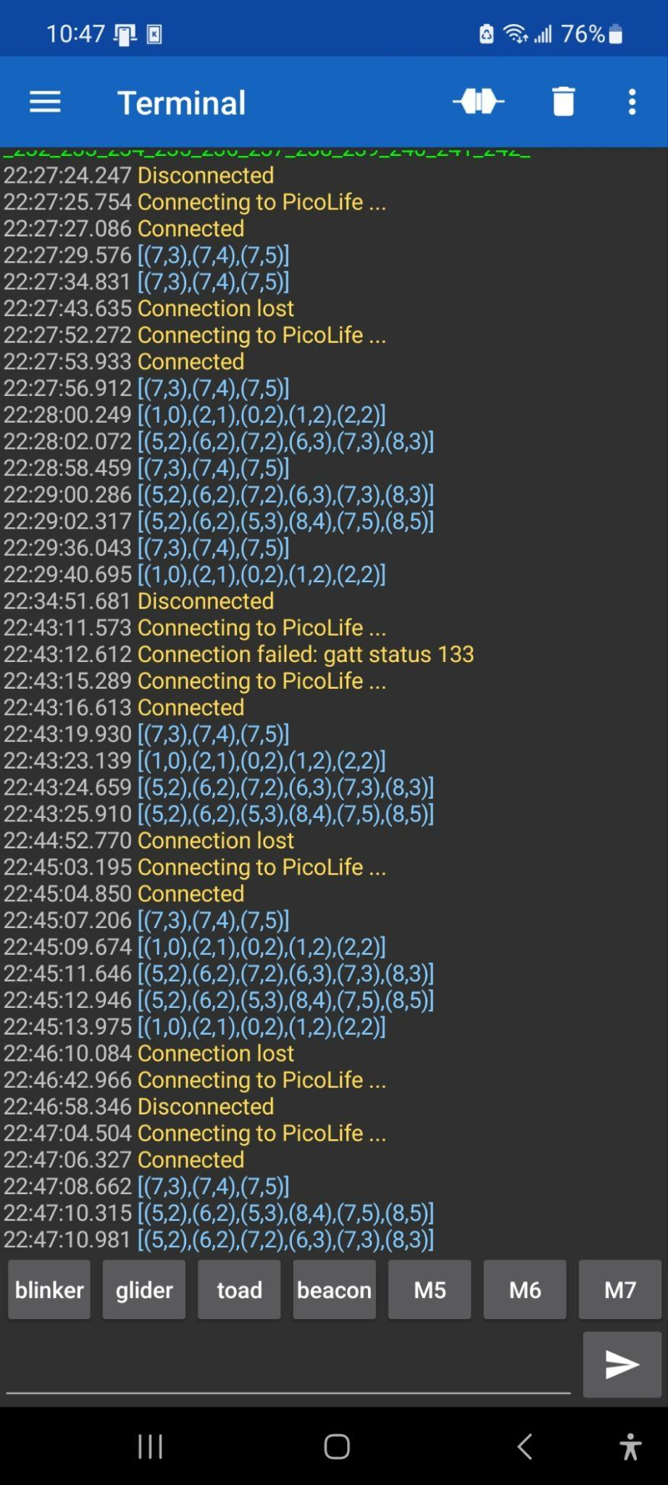
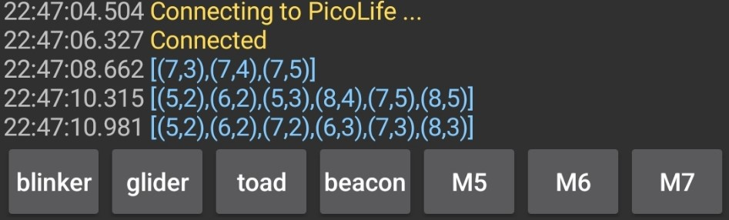
Bluetooth-based Configuration
Notes:
We have Bluetooth running on the Pico W, right? Are we sure? How do we test it out without writing the entire app?
This is an app named Serial Bluetooth Terminal that I download off of the Google App Store. It opens a connection to a Bluetooth device and then sends and receives text with the device.
It has a handy macro function and I assigned some Python source code to named macros. This is the proof-of-concept environment to test the Bluetooth code running on the Pico.

Slide 16
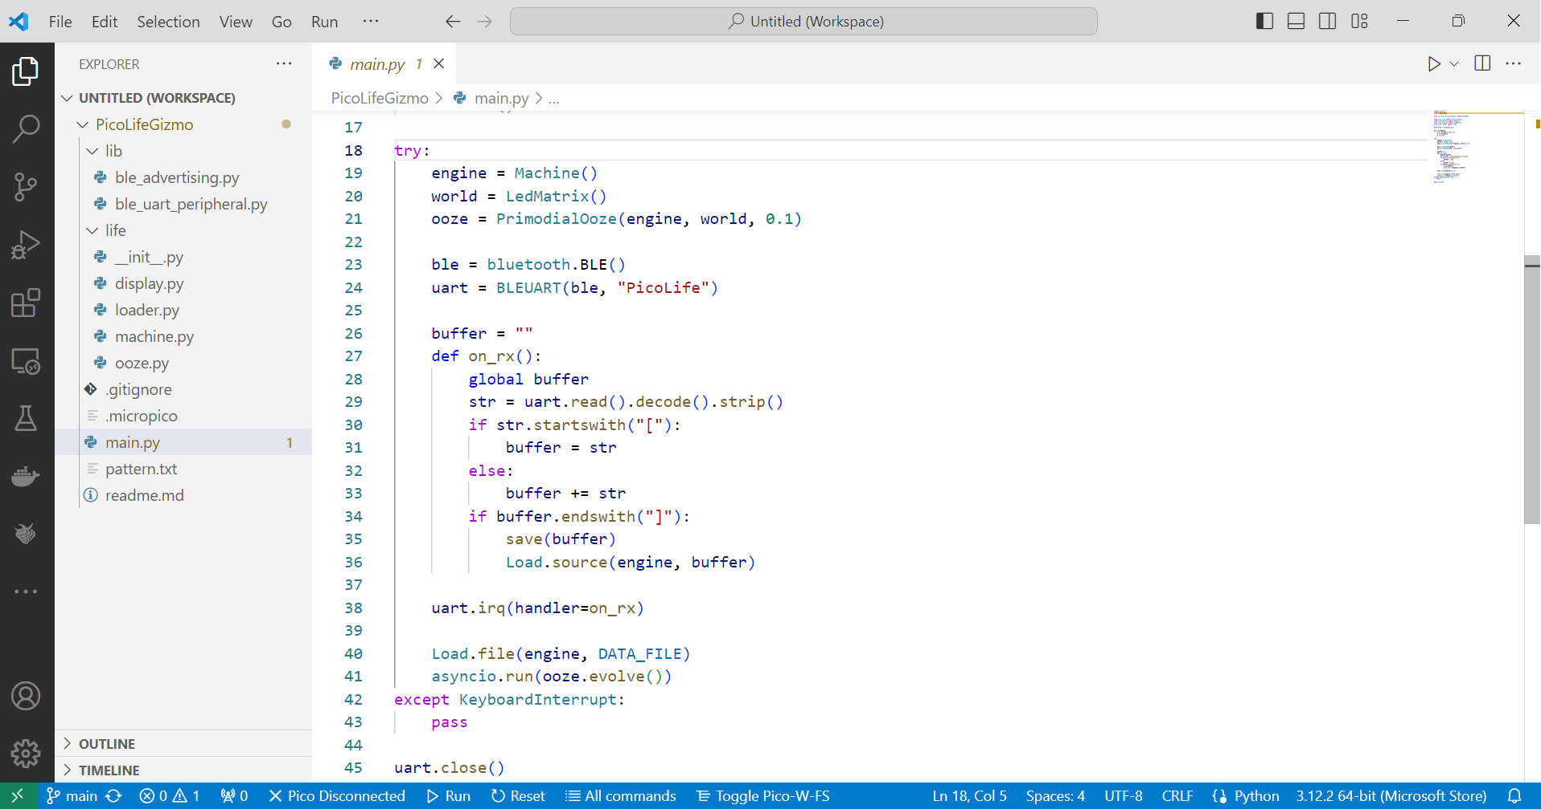
Buffering the UART Input
buffer = ""
def on_rx():
global buffer
str = uart.read().decode().strip()
if str.startswith("["):
buffer = str
else:
buffer += str
if buffer.endswith("]"):
save(buffer)
Load.source(engine, buffer)
Notes:
While testing with the terminal program, I found that a number of the macros didn’t seem to be working properly; the longer macros were causing the gadget to throw a syntax-error exception.
A few calls to print() revealed that my strings were being truncated. No problem. I’ll just buffer the data until I get a complete string delimited by square brackets.
And that concludes the evolution of the gadgets Bluetooth configuration interface. So far we have:
A gadget made with a Raspberry Pi Pico W.
A way to set configurations over Bluetooth.
A mechanism to persist configurations across reboots.
A tool to make sure it’s all working properly.
Next we’ll look at the Android app we’ll build to configure our gadget.

Slide 17
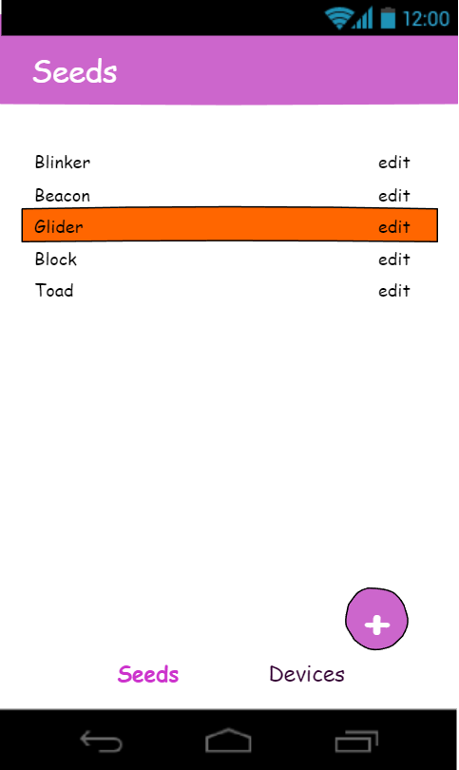
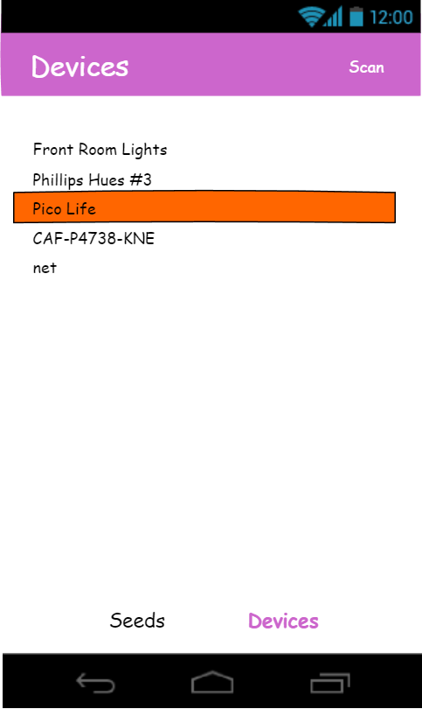
Mobile App Mockup
Notes:
Let’s get an idea of what we want to build. A ballpoint-and-napkin is all you really need or you can use a wireframe tool like Balsamiq or Pencil. You can also just crack open Visual Studio and start coding but after you’ve familiarized yourself with what’s available I still think that it’s a good idea to take a step back and clarify your ideas by sketching them out.
The mobile app is going to have two main screens.
The Seeds screen will show a list of patterns with buttons to add a new pattern, edit an existing pattern, and send the pattern to the gadget.
The Devices screen will manage the Bluetooth connection and provide buttons for scanning for available devices and connecting to a specific gadget.

Slide 18
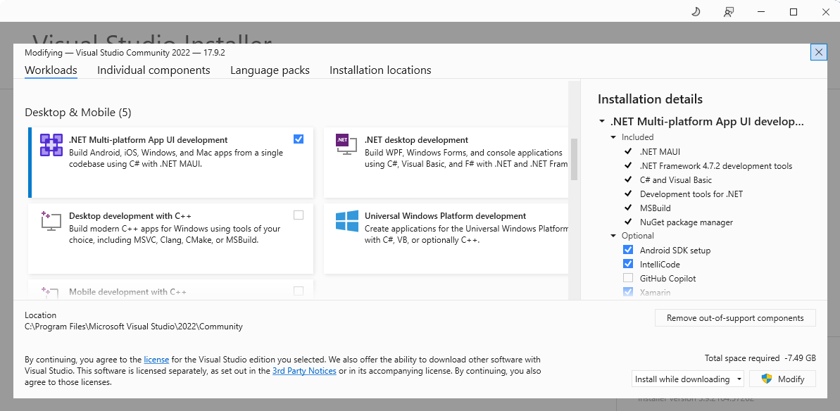
Visual Studio Setup
Notes:
We’ll be using Microsoft Visual Studio 2022 Community Edition to build the mobile app. Because I have an Android phone and not an iPhone I’ll be concentrating on building an Android app. If you want to build for iPhone there are tutorials on the web that will help out.
Fire up the Visual Studio Installer and install the .NET Multi-Platform App UI development workload.
After installing the workload, launch Visual Studio and create a new MAUI app solution.

Slide 19
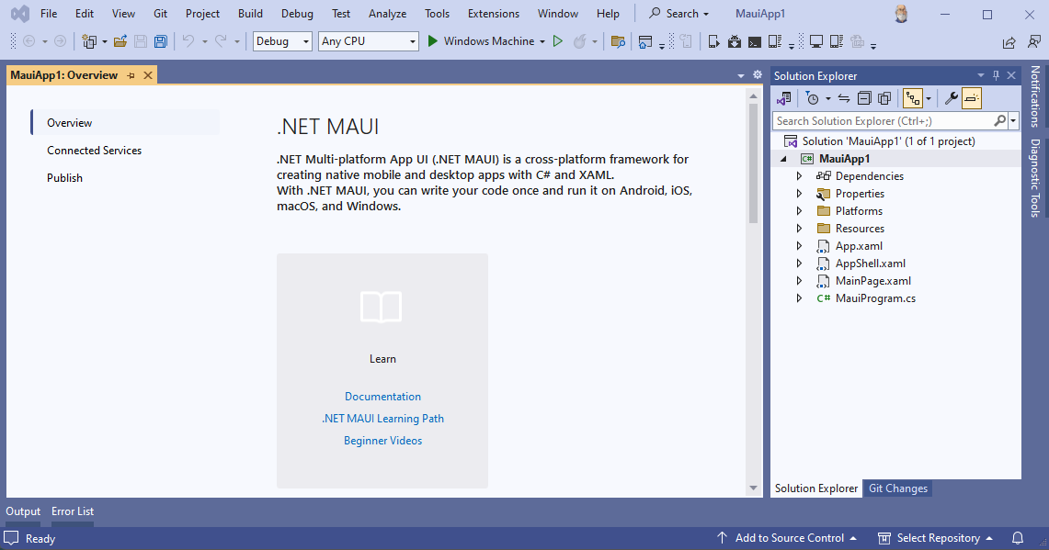
Visual Studio Setup
Notes:
The new solution has some example code and links for documentation and tutorials. I don’t know about you but I like to run any example code to make sure that my environment is set up correctly. Remember that the M in MAUI stands for multi-platform so let’s hit the Run button…

Slide 20
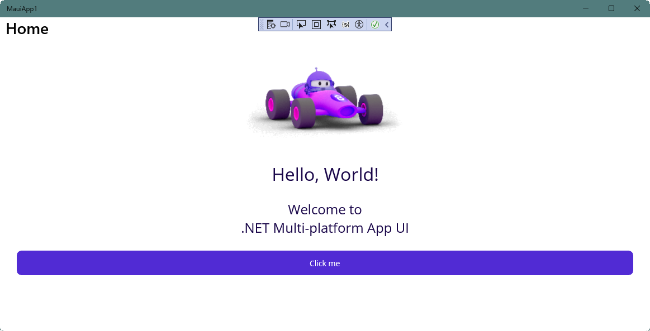
Visual Studio Setup
Notes:
… to see the example running under the Windows Machine target.

Slide 21
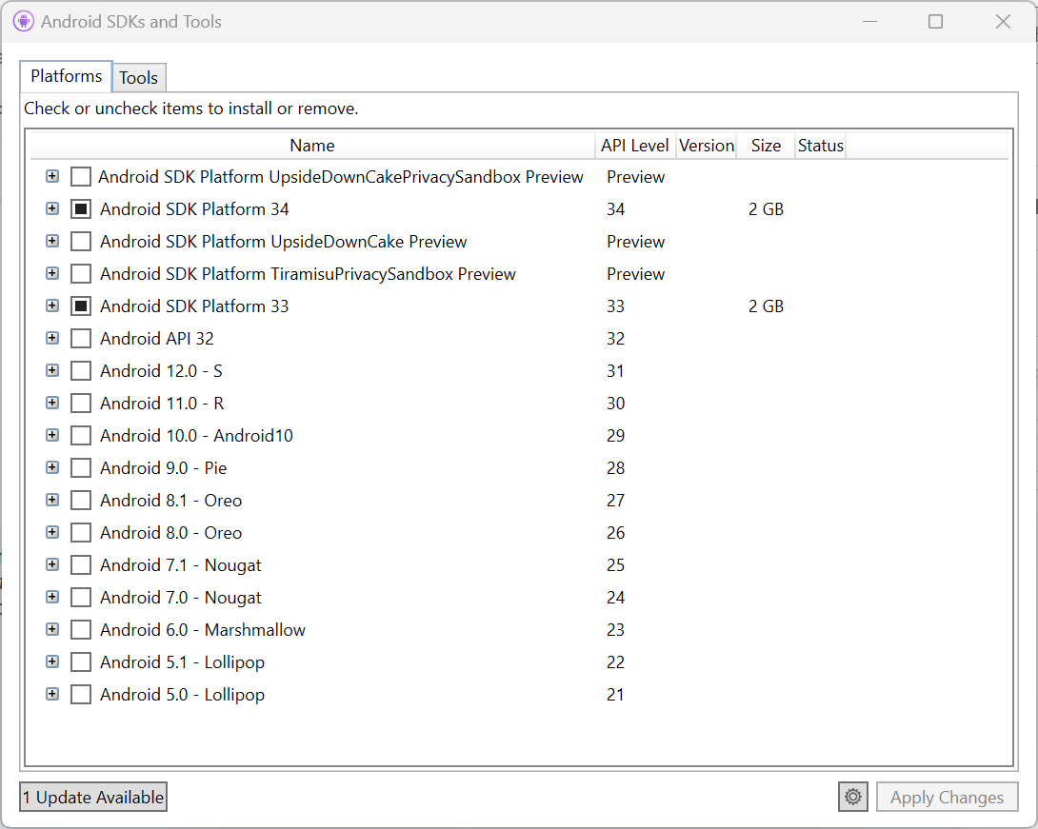
Visual Studio Setup for Android Development
Notes:
It’s nice that the example compiles and runs but that doesn’t get us to having multi- covered in the multi-platform promise. There are some tasks that we need to accomplish before we can debug our mobile app.
First we need to make sure that the Android SDK is installed, from the Tools menu select Android SDK Manager…

Slide 22
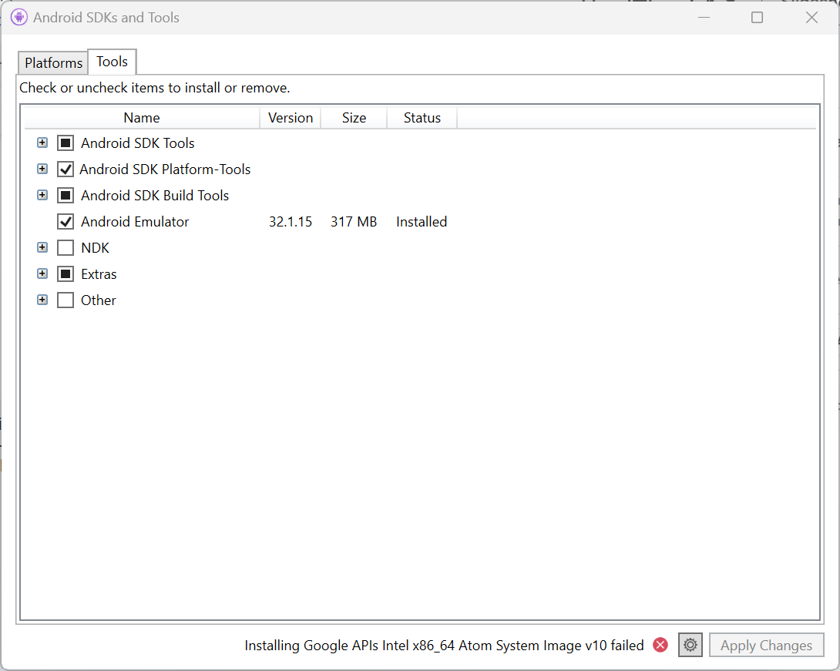
Visual Studio Setup for Android Development
Notes:
… with the correct tools.

Slide 23
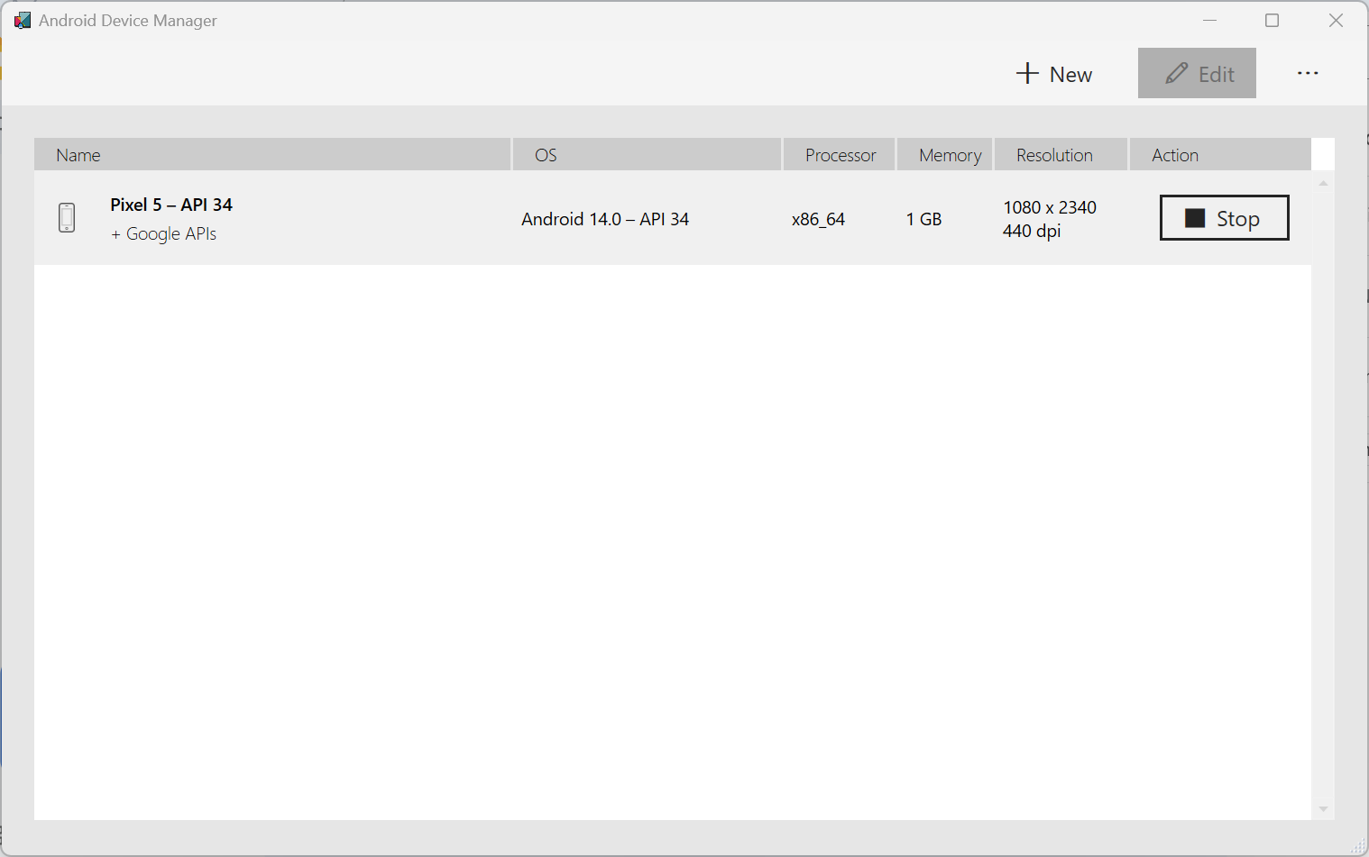
Visual Studio Setup for Android Development
Notes:
Make sure we have an emulator configured, from the Tools menu select Android Device Manager…
Create an emulator
Start the emulator

Slide 24
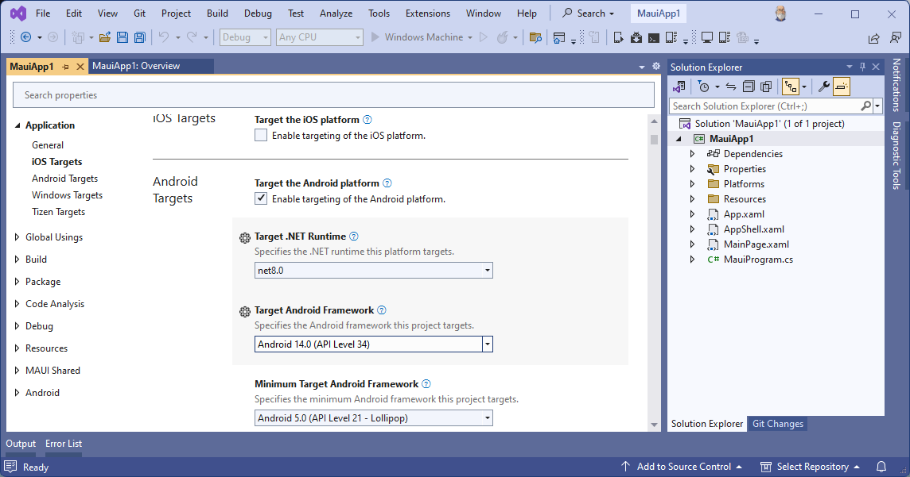
Visual Studio Project Setup for Android Development
Notes:
Next, we need to enable the Android target in the projects properties sheet.

Slide 25
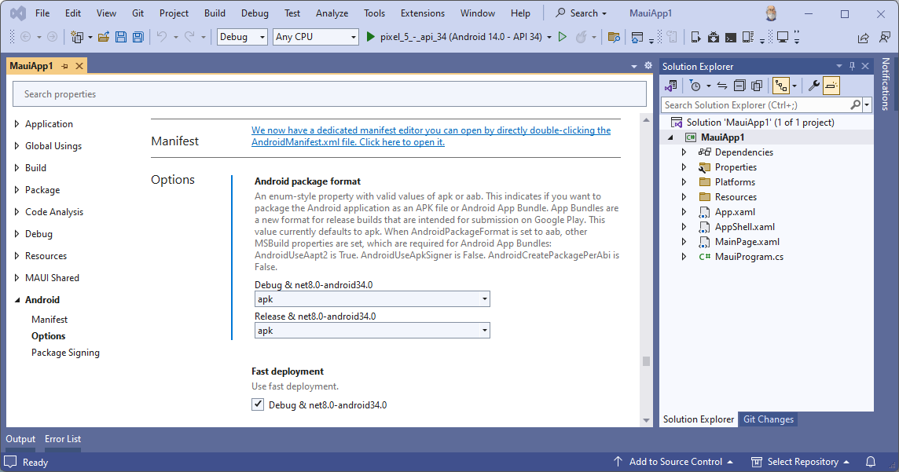
Visual Studio Project Setup for Android Development
Notes:
Because we’ll be side loading the app, set the Release package format to apk, also in project properties.

Slide 26
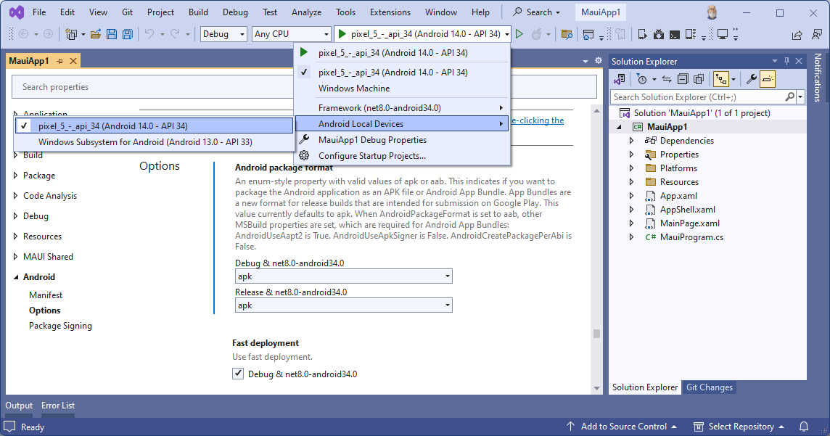
Visual Studio Setup
Notes:
Select the emulator that we created earlier, hit the Run button…

Slide 27
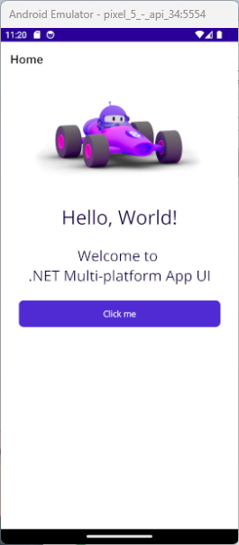
Visual Studio Setup
Notes:
…and marvel at our multi-platform app.

Slide 28
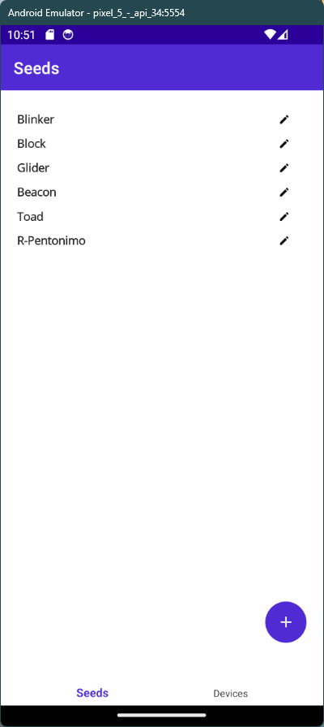
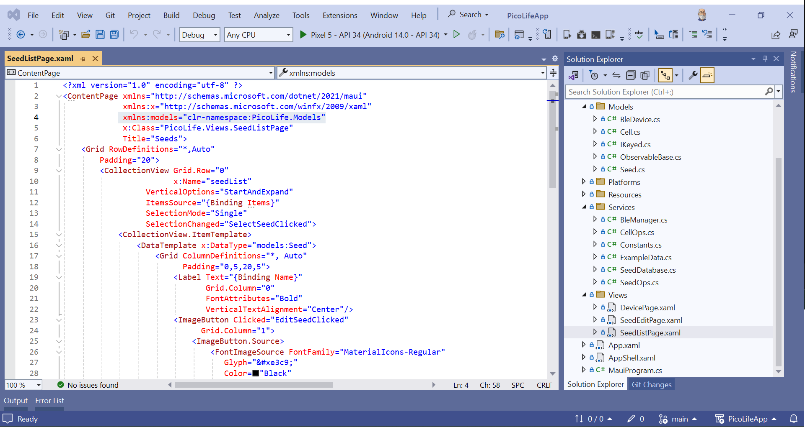
Pico Life App
Notes:
Finally we get to the whole point of this session - Multi-platform development with MAUI and .NET.
I’ll be concentrating on describing the features that I used to build the configuration tool for my gadget and the places where I stumbled. Remember the MAUI default project “Welcome” screen? There is a huge amount of information, both from Microsoft and from 3rd parties, on how to build apps with MAUI.

Slide 29
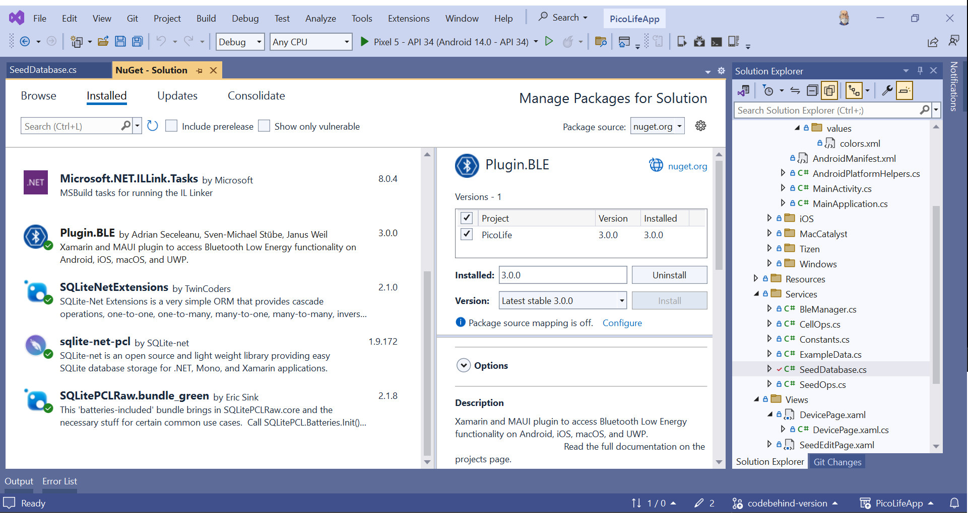
Pico Life App
Notes:
Just as we depended on third-party Python libraries for the microcontroller project, we’ll use third-party packages on the mobile app side as well.
The Plugin.BLE gives easy access to the Bluetooth Low Energy functionality on the mobile device.

Slide 30
Pico Life App
Notes:
While these SQLite packages give us a simple, on-device, relational store for our list of seeds.

Slide 31
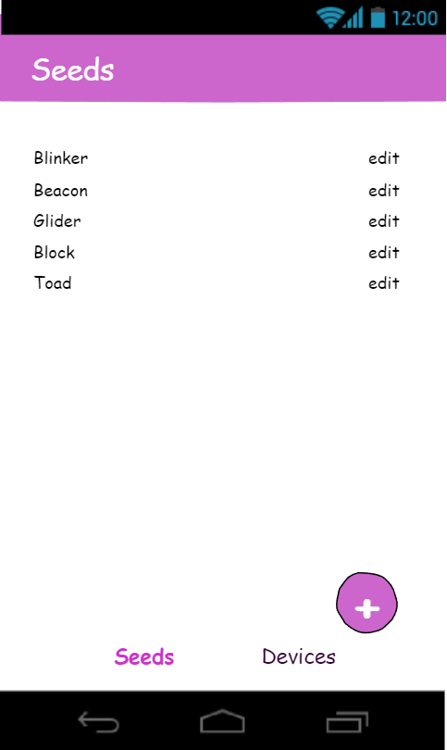
From Mockup To Mobile
MVVM vs. Code-behind
Dependency Injection
Defining the UI with XAML
Navigating between Screens
Interacting with the Hardware
Debugging on the Metal
Deploying to Android
Notes:
Here’s what we’ll cover in the rest of the session:
MVVM vs Code-behind
Dependency Injection
Defining the UI with XAML
Navigating between Screens
Functionality as Service
Interacting with the Hardware
Debugging on the Metal
Deploying to Android
That seems like a long list so I guess we’d better be at it.

Slide 32
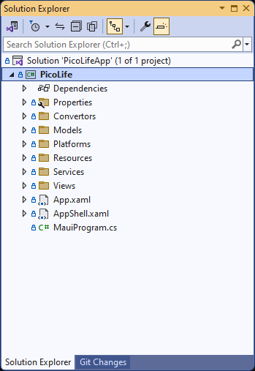
MVVM vs. Code-behind
Model - View - ViewModel | Code-behind
Loosely coupled | Tightly coupled
Rich example code | Has examples
Easily testable | Difficult to test
Separation of concerns | Big ball of mud
More maintainable | Spaghetti
Notes:
The Model-View-ViewModel pattern splits functionality into loosely coupled classes to provide better testability and maintainability of an application. In a large, commercial application you would want to use the MVVM pattern for just those reasons.
If you look at the Solution Explorer pane for the project you won’t see a folder called ViewModels. Like all patterns in software development, MVVM works best when there is a reason to use it.
Our application is very simple so we are going to dispense with the complexity of the MVVM pattern and use the code-behind model. Each view will consist of an XAML file describing the widgets and a C# file containing the code for manipulating the UI. The XAML will bind to properties of the class and event handlers will process user interactions.
If you decide to use the MVVM pattern in your app, you will definitely want to use the MVVM Community Toolkit. Many of the examples that you find on StackOverflow will be using the toolkit which is a plus and you’ll see how the toolkit helps to manage the complexity inherent in the MVVM model.

Slide 33
Dependency Injection
public DevicePage()
{
InitializeComponent();
BleManager = new BleManager();
}
public DevicePage(BleManager ble)
{
InitializeComponent();
BleManager = ble;
}
Notes:
Before getting into XAML, let’s look at interfacing the app with the mobile device. Your phone has a few radios, a camera, storage, and various internal sensors. Your app needs software to read from those devices and to control some of them. In our case we’ll have a class called BleManager to manage the Bluetooth radio.
Here are two methods for getting an instance of the BleManager into our DevicePage instance. In the first example, the BleManager is instantiated by the DevicePage constructor. This leads to tightly-coupled code. In the second example, an instance of the class is passed in via the constructor.

Slide 34
Dependency Injection
public DevicePage()
{
InitializeComponent();
BleManager = new BleManager();
}
public DevicePage(BleManager ble)
{
InitializeComponent();
BleManager = ble;
}
Notes:
We don’t want instance creation to be mucking about in our UI code-behind files so we’ll inject it into the app using dependency injection. The magic of automatically passing objects via the constructor is provided by an Inversion of Control container. This breaks the coupling between the DevicePage and the BleManager which in turn allows for better maintainability and a cleaner code base.

Slide 35
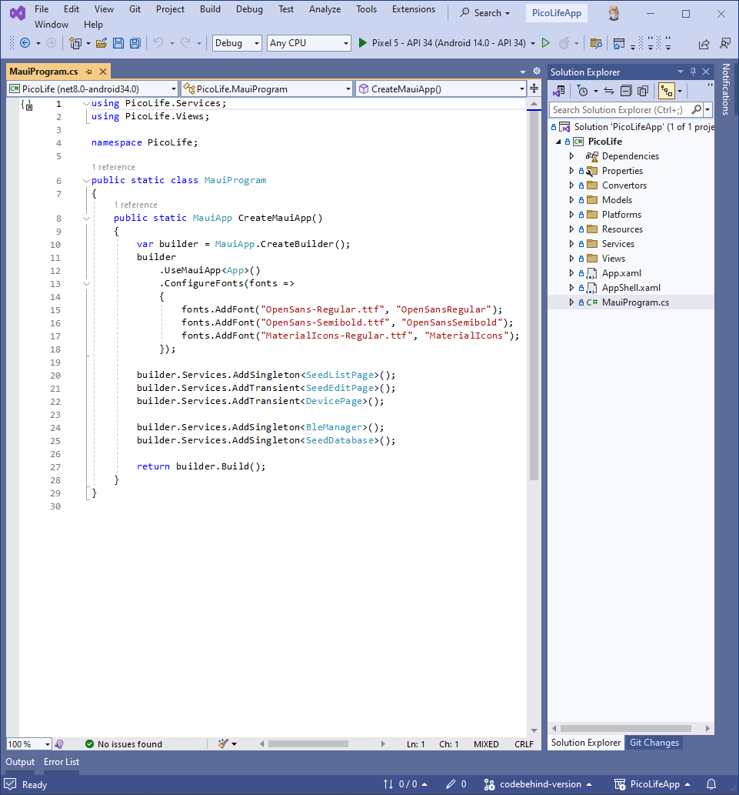
Dependency Injection
builder.Services.AddSingleton<BleManager>();
builder.Services.AddSingleton<SeedDatabase>();
Notes:
So how do we invoke this sweet, sweet magic?
The MauiProgram class is the entrypoint of the app and is created as part of the solution template.
We register the types of our service classes with the container. Here we are telling the container that whenever a BleManager is required, use the singleton instance that has already been created.

Slide 36
Dependency Injection
builder.Services.AddSingleton<SeedListPage>();
builder.Services.AddTransient<SeedEditPage>();
builder.Services.AddTransient<DevicePage>();
Notes:
We can also register transient objects. In this case the container will create a new instance of the SeedEditPage everytime we navigate to that page. The page will already have instances of dependencies that were injected during construction.

Slide 37
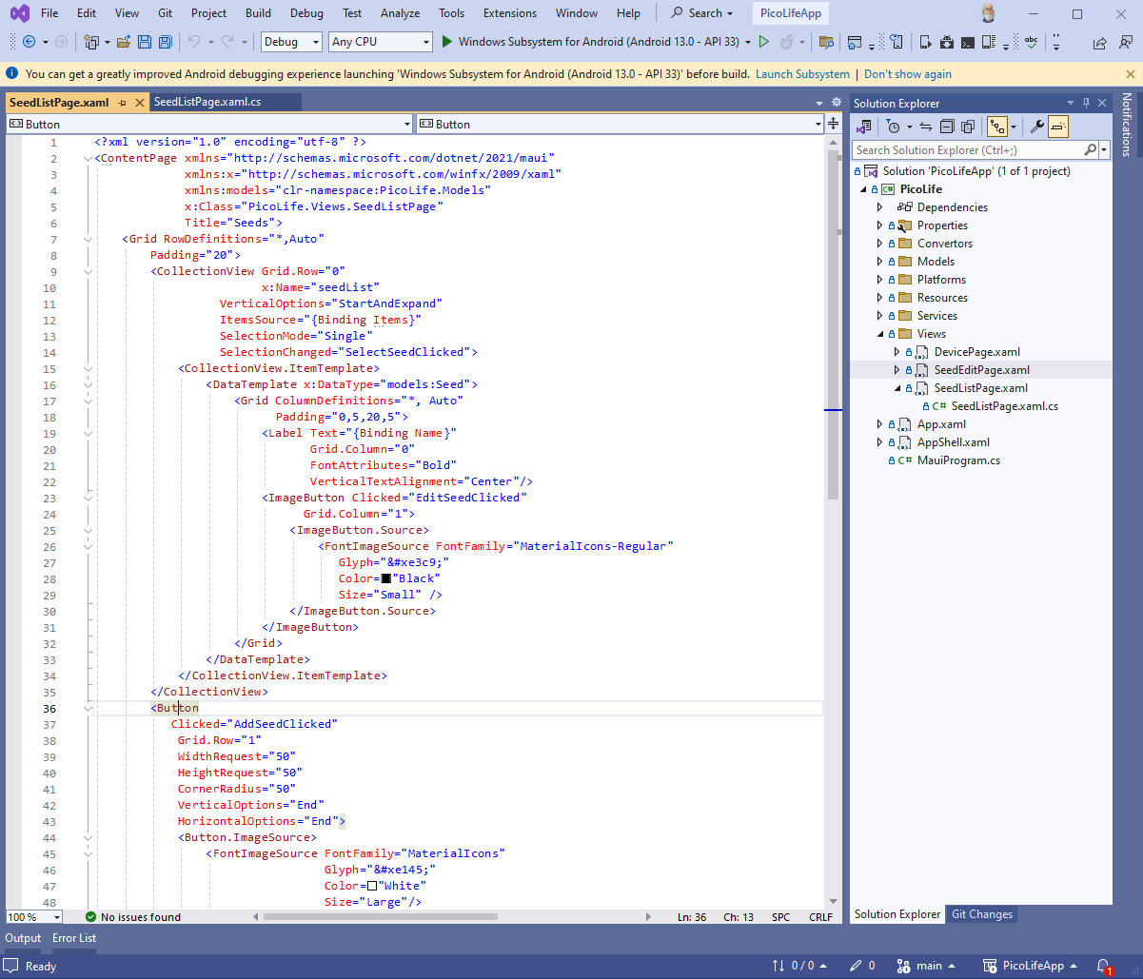
Defining the UI with XAML
Layouts
StackLayout
AbsoluteLayout
Grid
Canvas
<Grid RowDefinitions=”*,Auto”
<Grid ColumnDefinitions=”*,Auto”
Notes:
Extensible Application Markup Language or XAML is how we describe the user interface of our application. A XAML element describes either a Layout or a View. Properties on those elements refine visual details of the element, define child elements, and bind values to the underlying page instance.
Layouts
A layout determines how items are positioned on the screen. A StackLayout will position elements in a single row or column. A Grid layout will position things based on row and column identifiers. A Canvas gives you something to draw on.
StackLayout
AbsoluteLayout
Grid
Canvas

Slide 38
Defining the UI with XAML
Views
<CollectionView Grid.Row=”0”
Label
Button
CollectionView
ScrollView
Entry
<ImageButton Clicked=”EditSeedClicked”
Notes:
Views
Views are the actual components that the user will interact with. If you had a really long list of items to display you might put a CollectionView inside of a ScrollView. Your CollectionView might layout the properties of each item in a Grid layout which in turn uses Label views to display the items values.
Label
Button
CollectionView
ScrollView
Entry
The hierarchical nature of XAML might make you wish for a visual designer; that tool is named Blend and is included in a couple of the Visual Studio workloads. It is geared towards desktop and UWP development and is available with the Visual Studio Community Edition.
A simple app such as this doesn’t need a visual designer, using Hot XAML Reload you can easily tweak the UI.

Slide 39
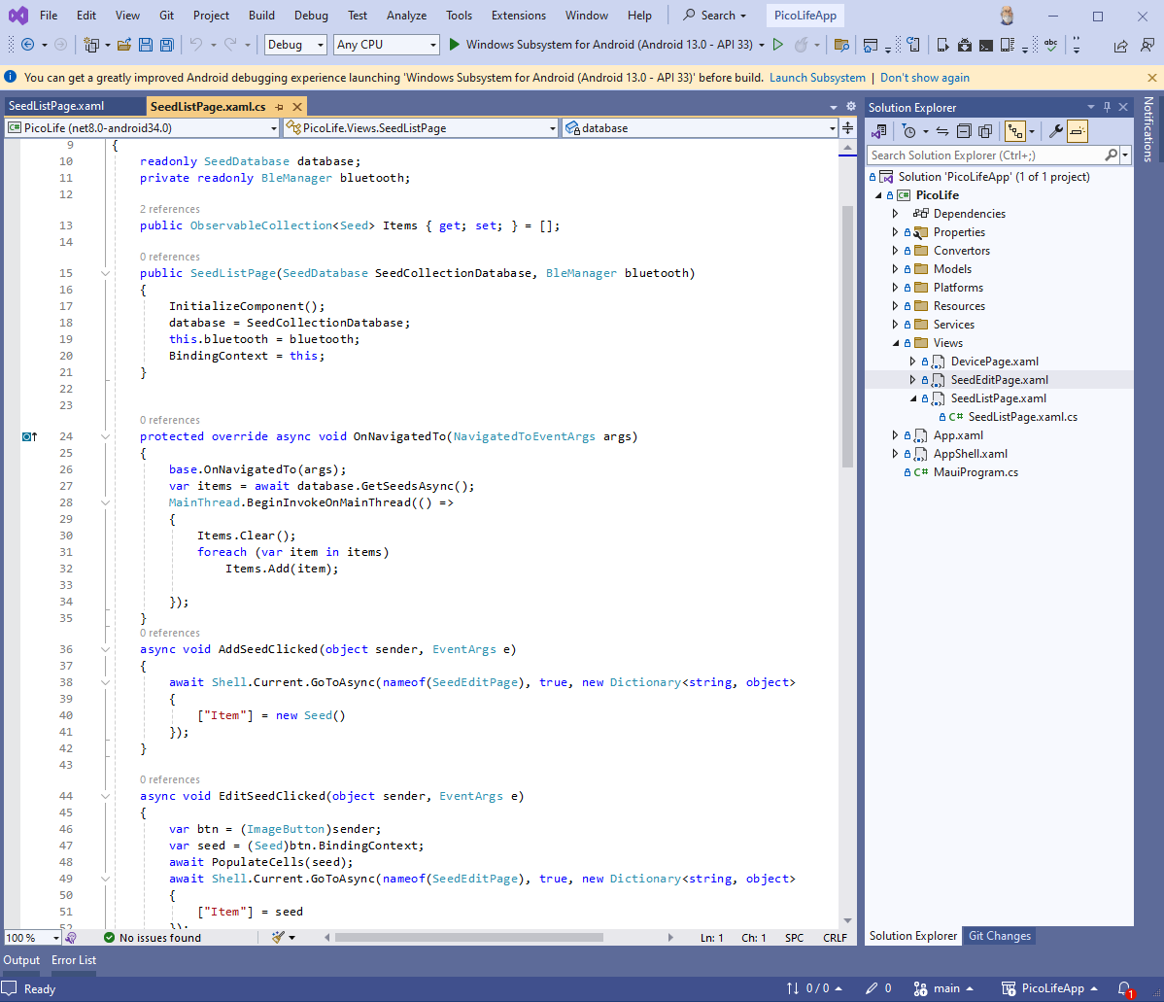
Defining the UI with XAML
Code behind contents
Properties
Event handlers
Service references
public ObservableCollection<Seed> Items { get; set; } = [];
Notes:
Every XAML file is going to have a corresponding C# file, aka the code-behind file. It is going to contain the actual code that is run when the user interacts with the app.
Properties hold values that the XAML will bind to for display. Properties can be scalars or collections.

Slide 40
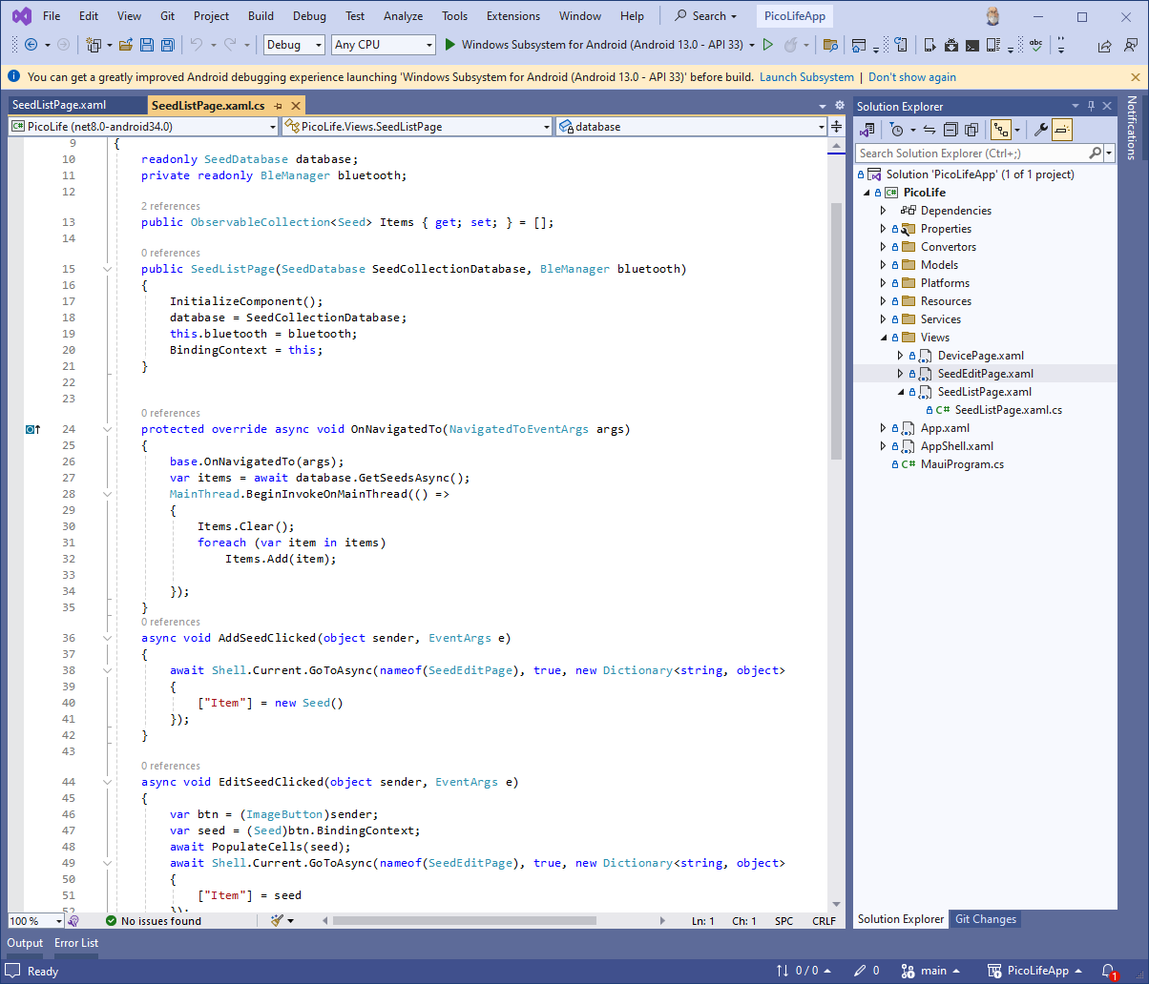
Defining the UI with XAML
Code behind contents
Properties
Event handlers
Service references
protected override async void OnNavigatedTo(NavigatedToEventArgs args)
Notes:
Event Handlers are invoked when the user interacts with the app or lifecycle events occur.

Slide 41
Defining the UI with XAML
Code behind contents
Properties
Event handlers
Service references
public SeedListPage(SeedDatabase SeedCollectionDatabase, BleManager bluetooth)
Notes:
Service references are instances of classes that provide persistence, validation, and other business logic. The code-behind file is where services are injected by the IoC container.

Slide 42
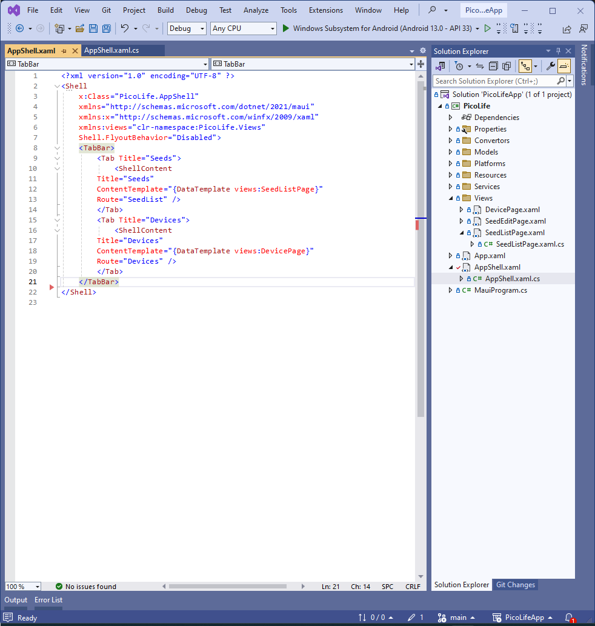
Navigating between Pages
<TabBar>
<Tab Title="Seeds">
<ShellContent Title="Seeds"
ContentTemplate="{DataTemplate …}"
Route="SeedList" />
</Tab>
<Tab Title="Devices">
<ShellContent Title="Devices"
ContentTemplate="{DataTemplate …}"
Route="Devices" />
</Tab>
</TabBar>
Notes:
The MAUI Shell contains a URI-based navigation mechanism that uses Routes to navigate to different pages of the app.
Using XAML, we can define a tabbar for navigating between the two main pages of the app.

Slide 43
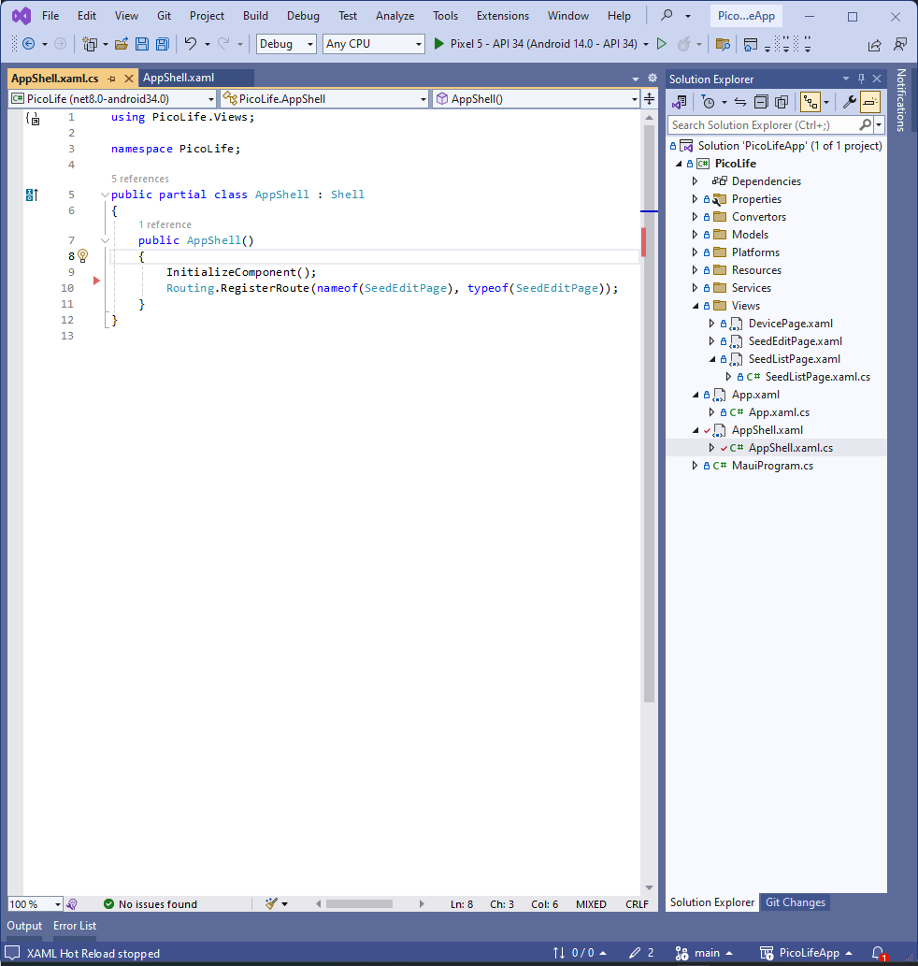
Navigating between Pages
Routing.RegisterRoute(nameof(SeedEditPage), typeof(SeedEditPage));
Notes:
What about other routes in the application? The buttons on the right of the Seeds list navigates to a page for editing a seed. We register that route in the code behind of the AppShell.xaml.cs …

Slide 44
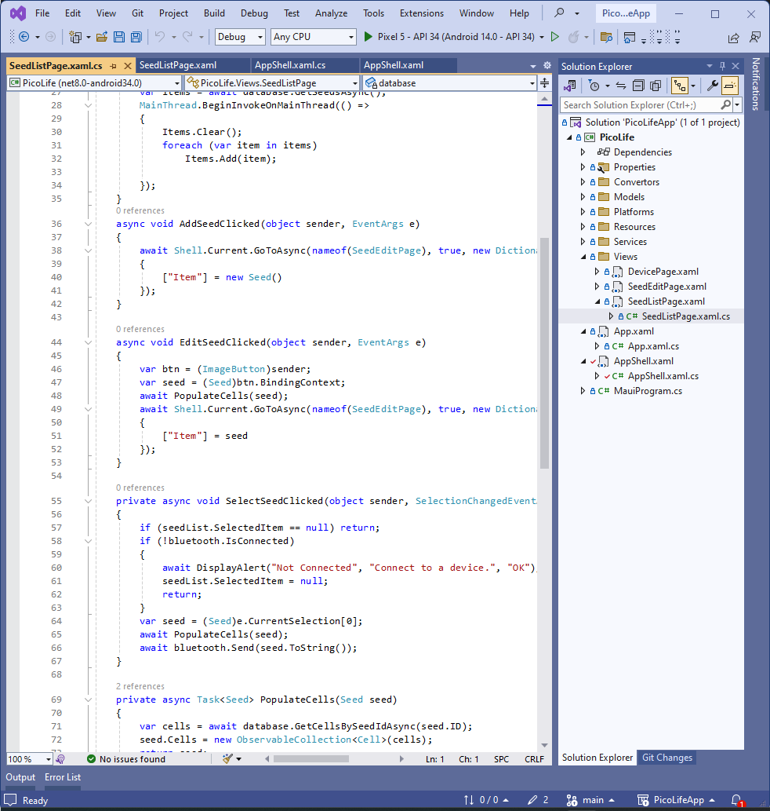
Navigating between Pages
async void EditSeedClicked(object sender, EventArgs e)
{
var btn = (ImageButton)sender;
var seed = (Seed)btn.BindingContext;
await PopulateCells(seed);
await Shell.Current.GoToAsync(nameof(SeedEditPage),
true,
new Dictionary<string, object>
{
["Item"] = seed
});
}
Notes:
… and in the event handler for the button we call Shell.Current.GoToAsync() with the seed as a parameter.

Slide 45
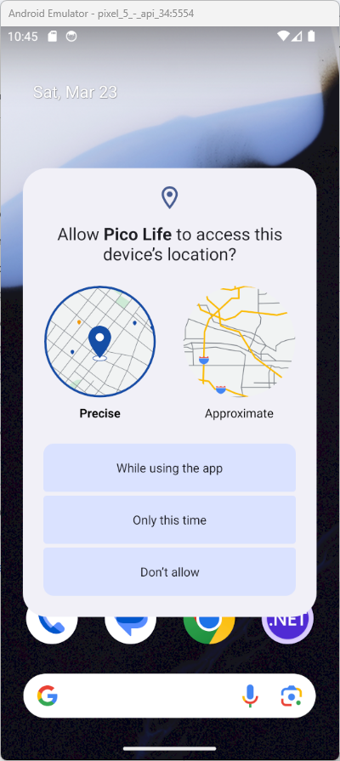
Interacting with the Hardware
https://developer.android.com/guide/topics/connectivity/bluetooth
Notes:
The BleManager class that I’ve alluded to controls scanning, connecting, and disconnecting from the gadget over the Bluetooth radio as well as sending data to the gadget. This is not the hard part, in fact with the amount of example code on the web it is pretty easy to take those examples and bend them into a shape that fits your app.
The hard part is getting the PERMISSIONS right. It seemed like every blog entry or Stackoverflow post listed a different set of permissions for getting Bluetooth running on Android.
Here is the secret. Bookmark the developer documentation for any platform that you are targeting. Once I added the correct permissions to the Android manifest file and the DroidPlatformHelpers class I was able to scan for the gadget.

Slide 46
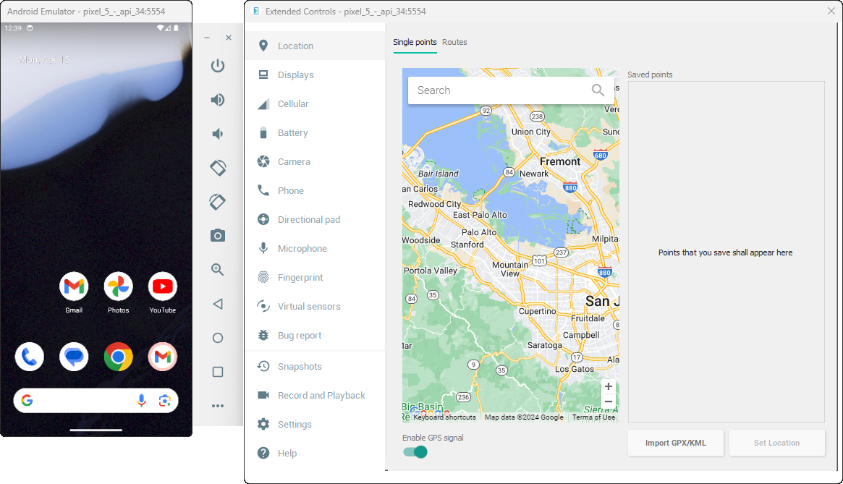
Debugging on the Emulator Metal
Notes:
The emulator gives you access to many parts of the emulated device such as the camera, mapping, and audio. Notice that the emulator has no support for emulating Bluetooth functionality.
How are we going to debug the Bluetooth code?
We could build a distribution, copy the apk to the device, install the app, and run the app. This could tell us that the app isn’t working properly but it doesn’t tell us where the problem is. If we want to debug the scanning and connection features of the app we need to do that on an actual mobile device.

Slide 47
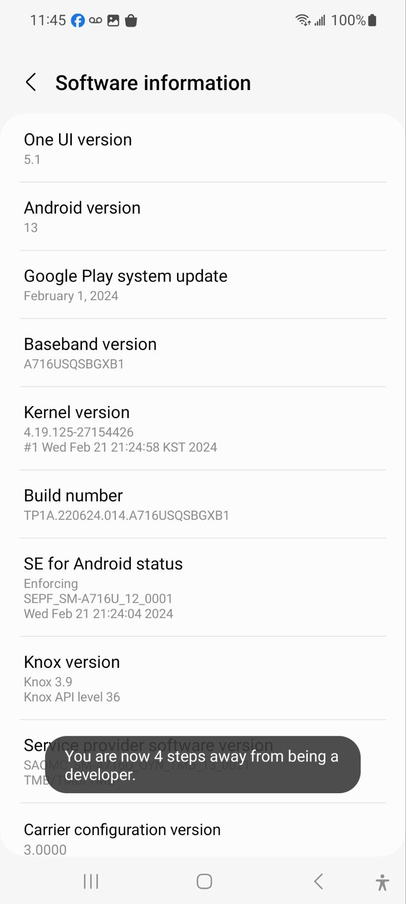
Debugging on the Metal
Tap 7 times
Notes:
We need to activate “developer mode” and “USB Debugging” on the phone.
Open up Settings on your Android device and navigate to About Phone, Software Information and tap 7 times on Build number …

Slide 48
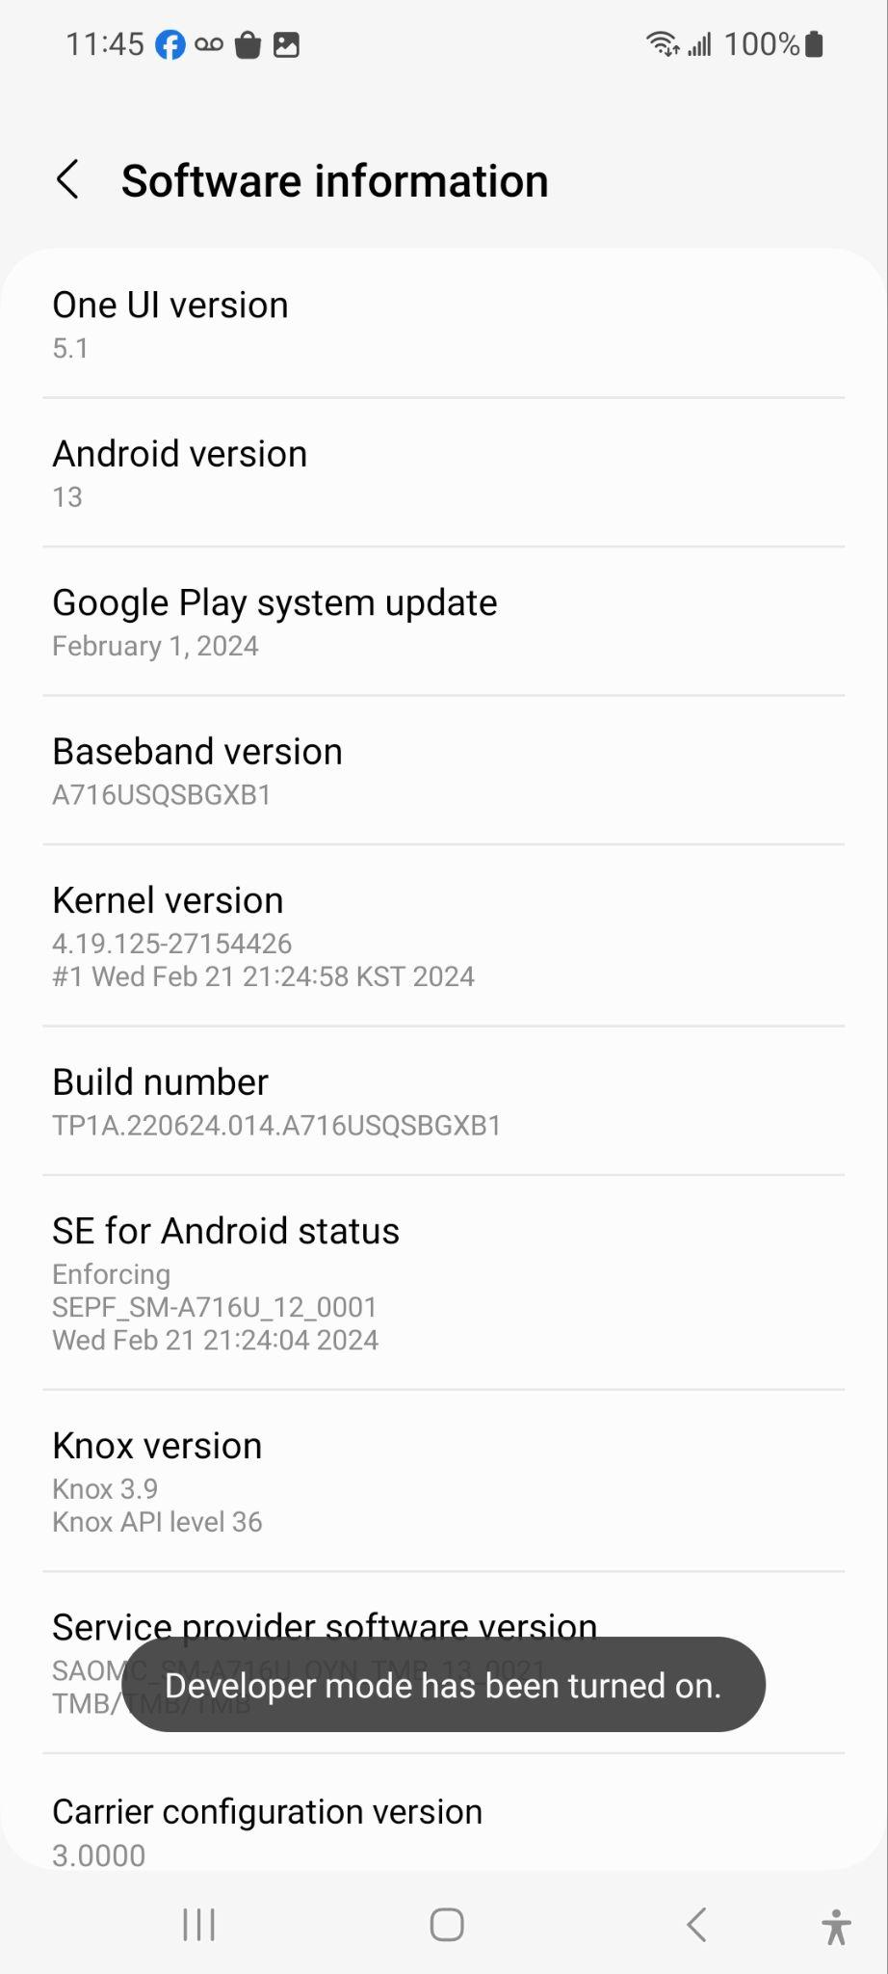
Debugging on the Metal
Notes:
… which will activate developer mode.

Slide 49
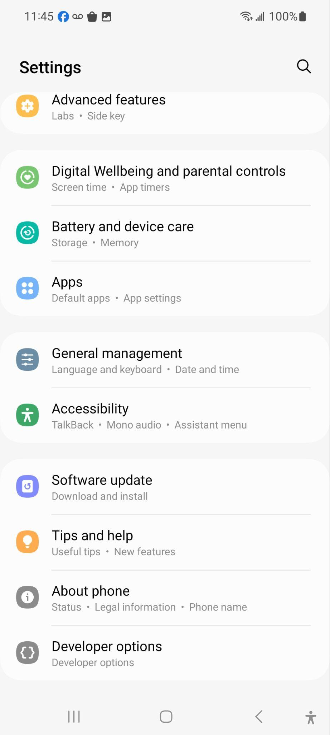
Debugging on the Metal
Notes:
Navigate back to Settings and select Developer Options…

Slide 50
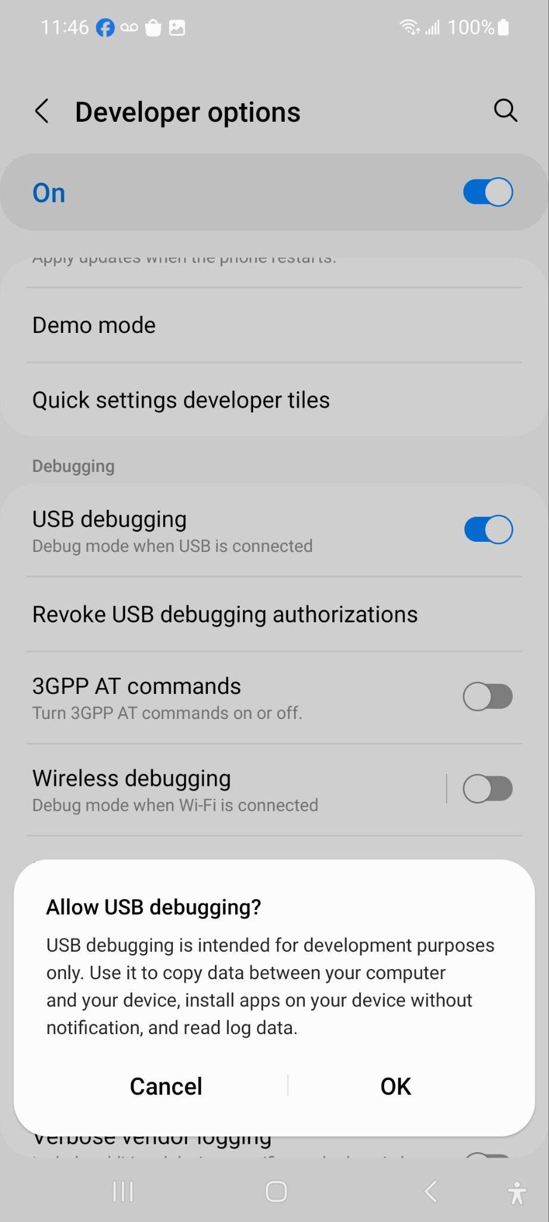
Debugging on the Metal
Notes:
… and enable USB Debugging

Slide 51
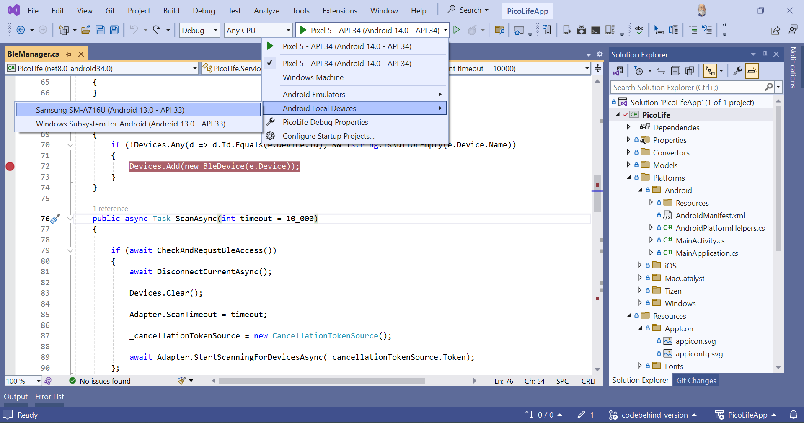
Debugging on the Metal
Notes:
After plugging in your device to a USB port on your development machine, you should be able to select the device, hit F5 …

Slide 52
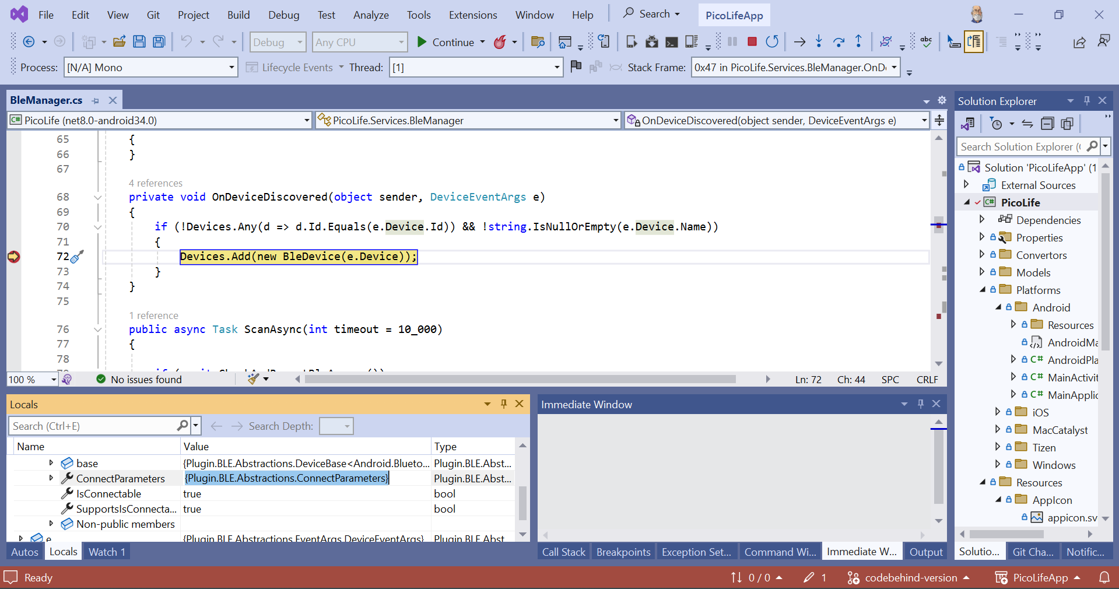
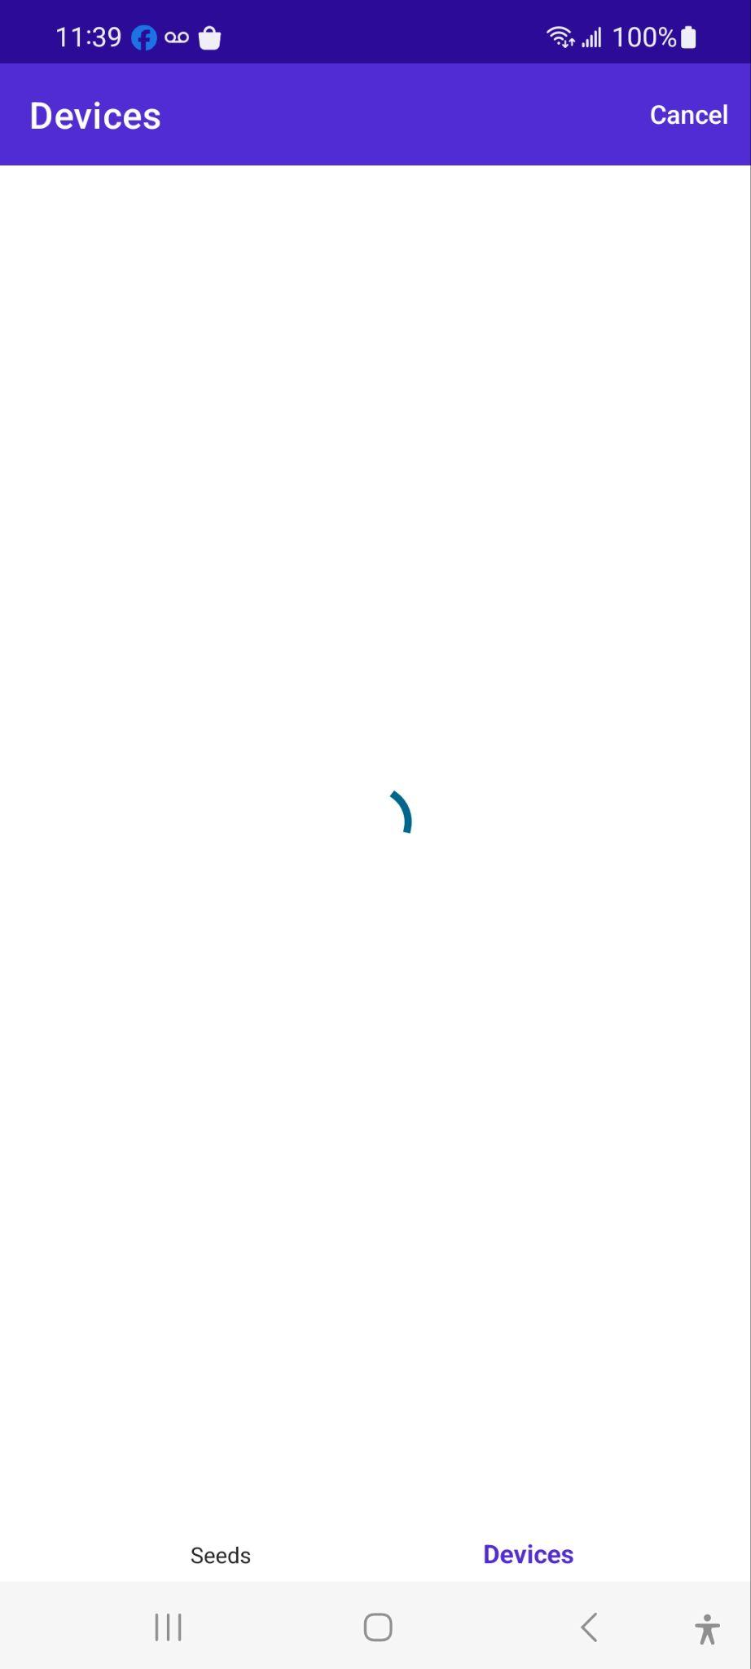

Debugging on the Metal
Notes:
… and debug the code as it’s running on the device. Here I’ve set a breakpoint in the device detected handler and the device is waiting patiently to continue.

Slide 53
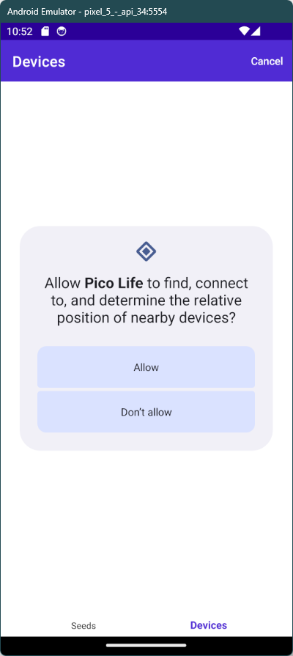
From Dev to Device
Build a Release
Publish
Distribute
Sign
Copy to device
Install
Notes:
Up until now we’ve been working in our development environment. It’s time to get our app onto a device so that we can actually use it when we are out and about in the real world. To do that, we need to:
Build a Release
Publish
Distribute
Sign
Copy to device
Install

Slide 54
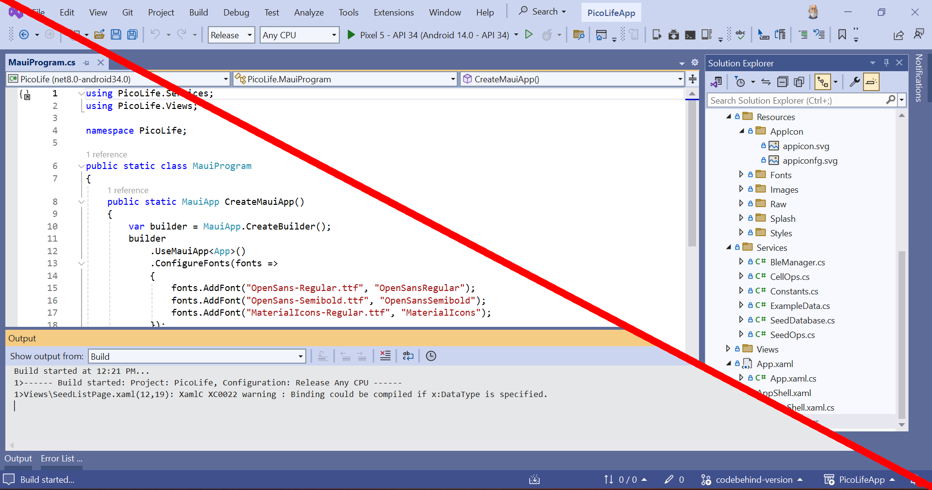
Build a Release
Notes:
First we’ll build a release. Select Release from the Solution Configuration drop down and then Build from the menu.

Slide 55


Package the Binaries and Resources
Notes:
Next we need to package the release into a form that we can transfer to our mobile device. Selecting Publish from the menu will package up the code and resources into an apk file. Remember when we were setting up the Android properties and we select apk as the package format? This is why.

Slide 56

Select the Distribution Channel
Requires the bundle format.
Notes:
Click the Distribute button to bring up the channel selection dialog.
Because the package format is apk the Ad Hoc button is highlighted. If you want to distribute your app over Google Play you need to change the package format to bundle in the project properties.

Slide 57

Create a Signing Identity
Notes:
Finally, we need to sign the package. Create a signing identity by clicking the big PLUS button…

Slide 58

Sign the Package for Distribution
Notes:
… and after saving the file we’ll sign the package.

Slide 59


Copy to Device and Install
Notes:
We’re almost there!
Copy the signed apk file to your mobile device.
Navigate to the Downloads folder on your device and open the apk file.
If you get a “Bad Format…” error it just means that you are trying to install an unsigned package. Make sure that you copy the file from the signed apks folder.
Once the app finishes installing, click the Open button to run the app.
We’ve covered a lot of ground this morning but screenshots and gifs don’t give you any idea of how it feels to build an app with MAUI.

Slide 60

“The digital conveyor is more art than science.”
So is live coding!
Notes:
That must mean it’s DEMO TIME!
As it turns out, the buttons on the configuration app that navigate to the edit screen are very small. More often than not, when tapping a button to edit a seed, we send the seed to the gadget instead.
Another problem is that we check for Bluetooth permissions when we start scanning. That’s not a problem itself but it is a little jarring the first time it happens because the assumption is that after you install the app it should be ready for use. Instead, let’s check for those permissions on first launch of the app. It’s a subtle difference but it is the kind that can make your app nicer for your users.
An offering to the Demo gods.
Change the button size to Medium.
Change ImageButton to Button.
Add BackgroundColor={StaticResource Primary} to the Button.
Debug to show the bigger buttons..
Click Edit and crash
Set breakpoint in SeedListPage EditSeedbuttonClicked
Click Edit
Hit the breakpoint.
Note that the cast is no invalid since we changed the button class.
Change the cast in SeelListPage.cs EditSeedButtonClicked()
Stop/Start the debugger
Click Edit
Pause at breakpoint
F5 to continue
???
Profit!
Add permissions check to the SeedsList page.
Reset the emulator.
Debug to show desired behaviour.

Slide 61

Intro To MAUI For Makers
Dennis Dunn
ansofive@gmail.com
https://dennisdunn.github.io
TL;DR; Multi-platform development is easy with MAUI.
Notes:
There is still much more in the MAUI eco-system. Some things we didn’t cover are:
Sharing resources across views with resource dictionaries
Advanced binding paths
Changing icons and colors
Local data persistence
That being said; Don’t worry about it! If you can identify the business end of a soldering iron then you have what it takes to write a multi-platform, mobile app for configuring your gadget. Start with some sample code and mold it into what you need. Pretty soon you’ll be driving your microbrewery rover around the block and your neighbors won’t know what to think!
Thanks for coming to my session. I’ll see you around.

Slide 62
Intro To MAUI For Makers
Pico Life Gadget
https://github.com/dennisdunn/PicoLifegadget
https://en.wikipedia.org/wiki/Conway's_Game_of_Life
https://github.com/monkmakes/mm_wlan
https://github.com/miguelgrinberg/microdot
https://github.com/micropython/micropython/blob/master/examples/bluetooth/
Pico Life App
https://github.com/dennisdunn/PicoLifeApp
https://learn.microsoft.com/en-us/dotnet/maui/what-is-maui?view=net-maui-8.0
https://learn.microsoft.com/en-us/dotnet/architecture/maui/
https://learn.microsoft.com/en-us/dotnet/communitytoolkit/mvvm/
Android Development
https://developer.android.com/guide

Slide 63
ACHTUNG!
Alles touristen und non-technischen looken peepers!
Das computermachine ist nicht fuer gefingerpoken und mittengrabben.
Ist easy schnappen der springenwerk, blowenfusen und poppencorken mit spitzensparken. Ist nicht fuer gewerken bei das dumpkopfen.
Das rubbernecken sichtseeren keepen das cotten-pickenen hans in das pockets muss; relaxen und watchen das blinkenlichten.

